Slide 1
Resampling results
11 August, 2023

Slide 2
Pre-processing steps: QC and adaptor-trimming with FASTP
tag-filtering (find transposon tag)
mapping/alignment (bwa-mem)
removing duplicate reads
* avg seq length = 151
*raw: not quality filtered
sample | Experiment | fastq reads* | TGTTA reads | % with tags | mapped reads | dup reads | template reads | sample 2 | reads TA sites | % reads hit TA | TA's hit | insertion density | max count | max site | NZ mean
A1 | Men + 1 | 64796903 | 64105656 | 98.9 | 62078208 | 9974704 | 52103504 | A1 | 51790112 | 99.4 | 30384 | 41.3 | 35668 | 2560633 | 1704.5
A2 | Men + 2 | 27327693 | 25912575 | 94.8 | 23315608 | 2067639 | 21247969 | A2 | 21020541 | 98.9 | 14864 | 20.2 | 44234 | 2856426 | 1414.2
B1 | Men - 1 | 3312969 | 3227812 | 97.4 | 2894890 | 272198 | 2622692 | B1 | 2607862 | 99.4 | 12614 | 17.2 | 4134 | 2540877 | 206.7
B2 | Men - 2 | 59668345 | 58555393 | 98.1 | 54511011 | 3899110 | 50611901 | B2 | 50202109 | 99.2 | 35024 | 47.6 | 50235 | 2200984 | 1433.4
C1 | Men + 1 | 5240906 | 5040493 | 96.2 | 4170196 | 130756 | 4039440 | C1 | 4000616 | 99 | 23713 | 32.2 | 6492 | 2371846 | 168.7
C2 | Men + 2 | 14854011 | 14368343 | 96.7 | 12320144 | 590331 | 11729813 | C2 | 11596280 | 98.9 | 15555 | 21.2 | 33669 | 2856426 | 745.5
D1 | Men - 1 | 46601908 | 46086206 | 98.9 | 44185634 | 3667580 | 40518054 | D1 | 40321820 | 99.5 | 35024 | 47.6 | 38046 | 558545 | 1151.3
D2 | Men - 2 | 5057770 | 4917158 | 97.2 | 4276826 | 110660 | 4166166 | D2 | 4136321 | 99.3 | 25385 | 34.5 | 6755 | 2200984 | 162.9
Mb09 | in vivo lung 9544 | 62315221 | 61488783 | 98.7 | 58697940 | 14476773 | 44221167 | Mb09 | 43948440 | 99.4 | 12433 | 16.9 | 113947 | 1729595 | 3534.8
Mb24 | in vivo LN 9544 | 21749238 | 21500454 | 98.9 | 20073840 | 4974006 | 15099834 | Mb24 | 15024799 | 99.5 | 9328 | 12.7 | 94654 | 1729595 | 1610.7
sample | Experiment | fastq reads | TGTTA reads | % with tags | mapped reads | dup reads | template reads | sample | reads TA sites | % reads hit TA | TA's hit | insertion density | max count | max site | NZ mean
Mb09 old | in vivo lung 9544 | 26716751 | 24888370 | 93.2 | 24229902 |  |  | Mb09 old | 23639206 | 97.6 | 18323 | 24.9 | 540142 | 1729595 | 1290.1
Mb24 old | in vivo LN 9544 | 18849917 | 17966351 | 95.3 | 17548715 |  |  | Mb24 old | 17181684 | 97.9 | 17250 | 23.5 | 700036 | 1729595 | 996

Slide 3
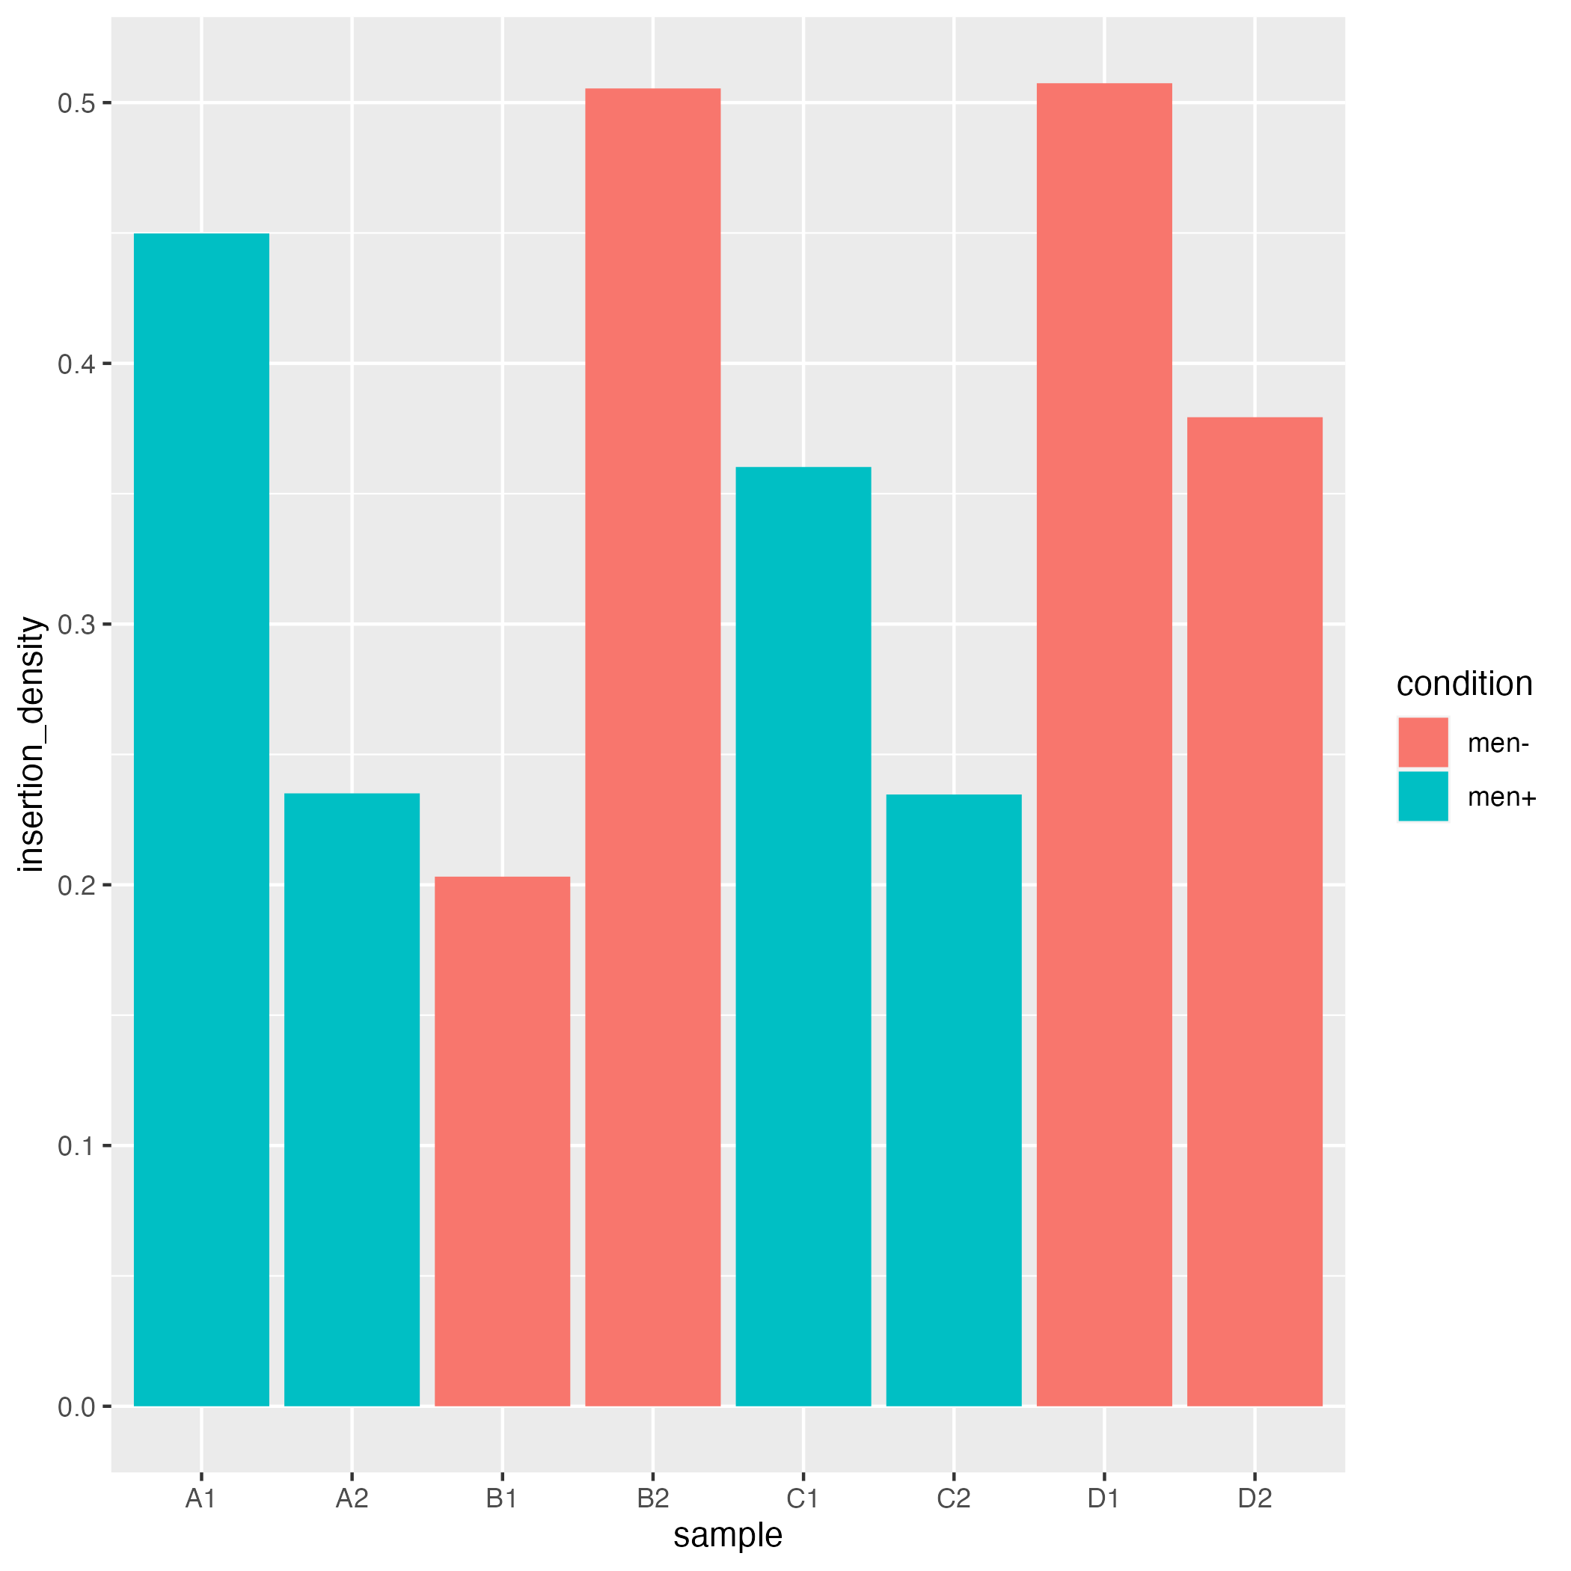
Insertion density
Library 1, positive: 50%
Library 1, negative: 52%
Library 2, positive: 27%
Library 2, negative: 53%
Pooled libraries, positive: 53%
Pooled libraries, negative: 63%

Slide 4
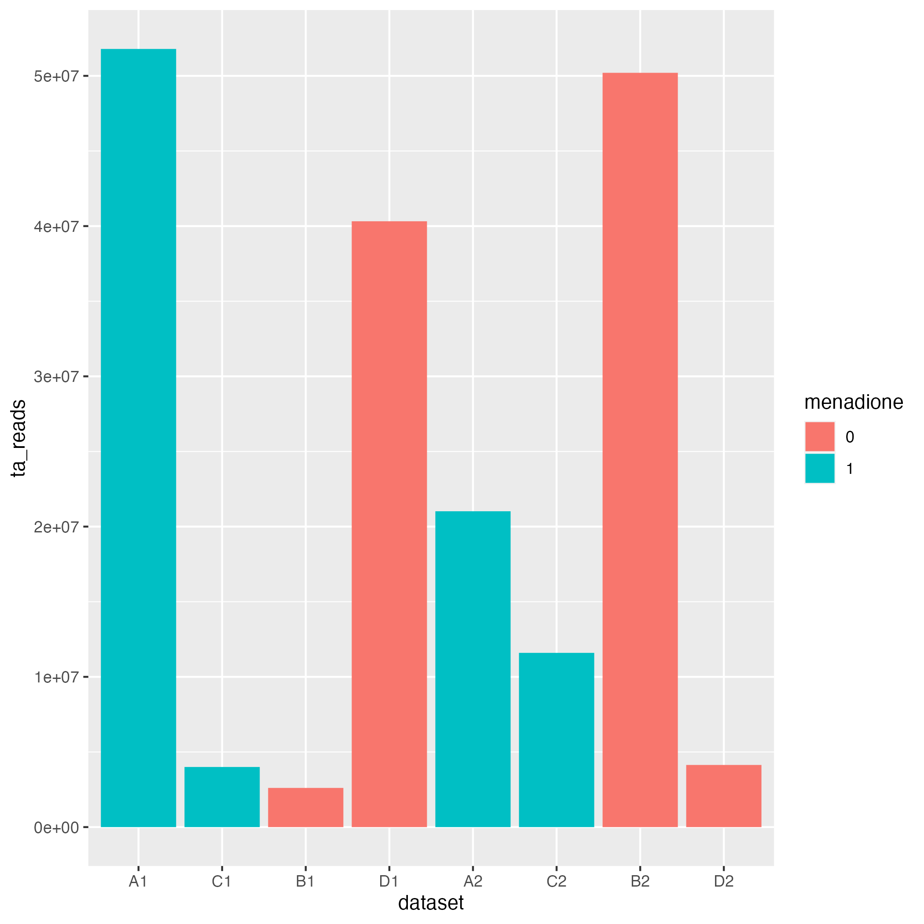
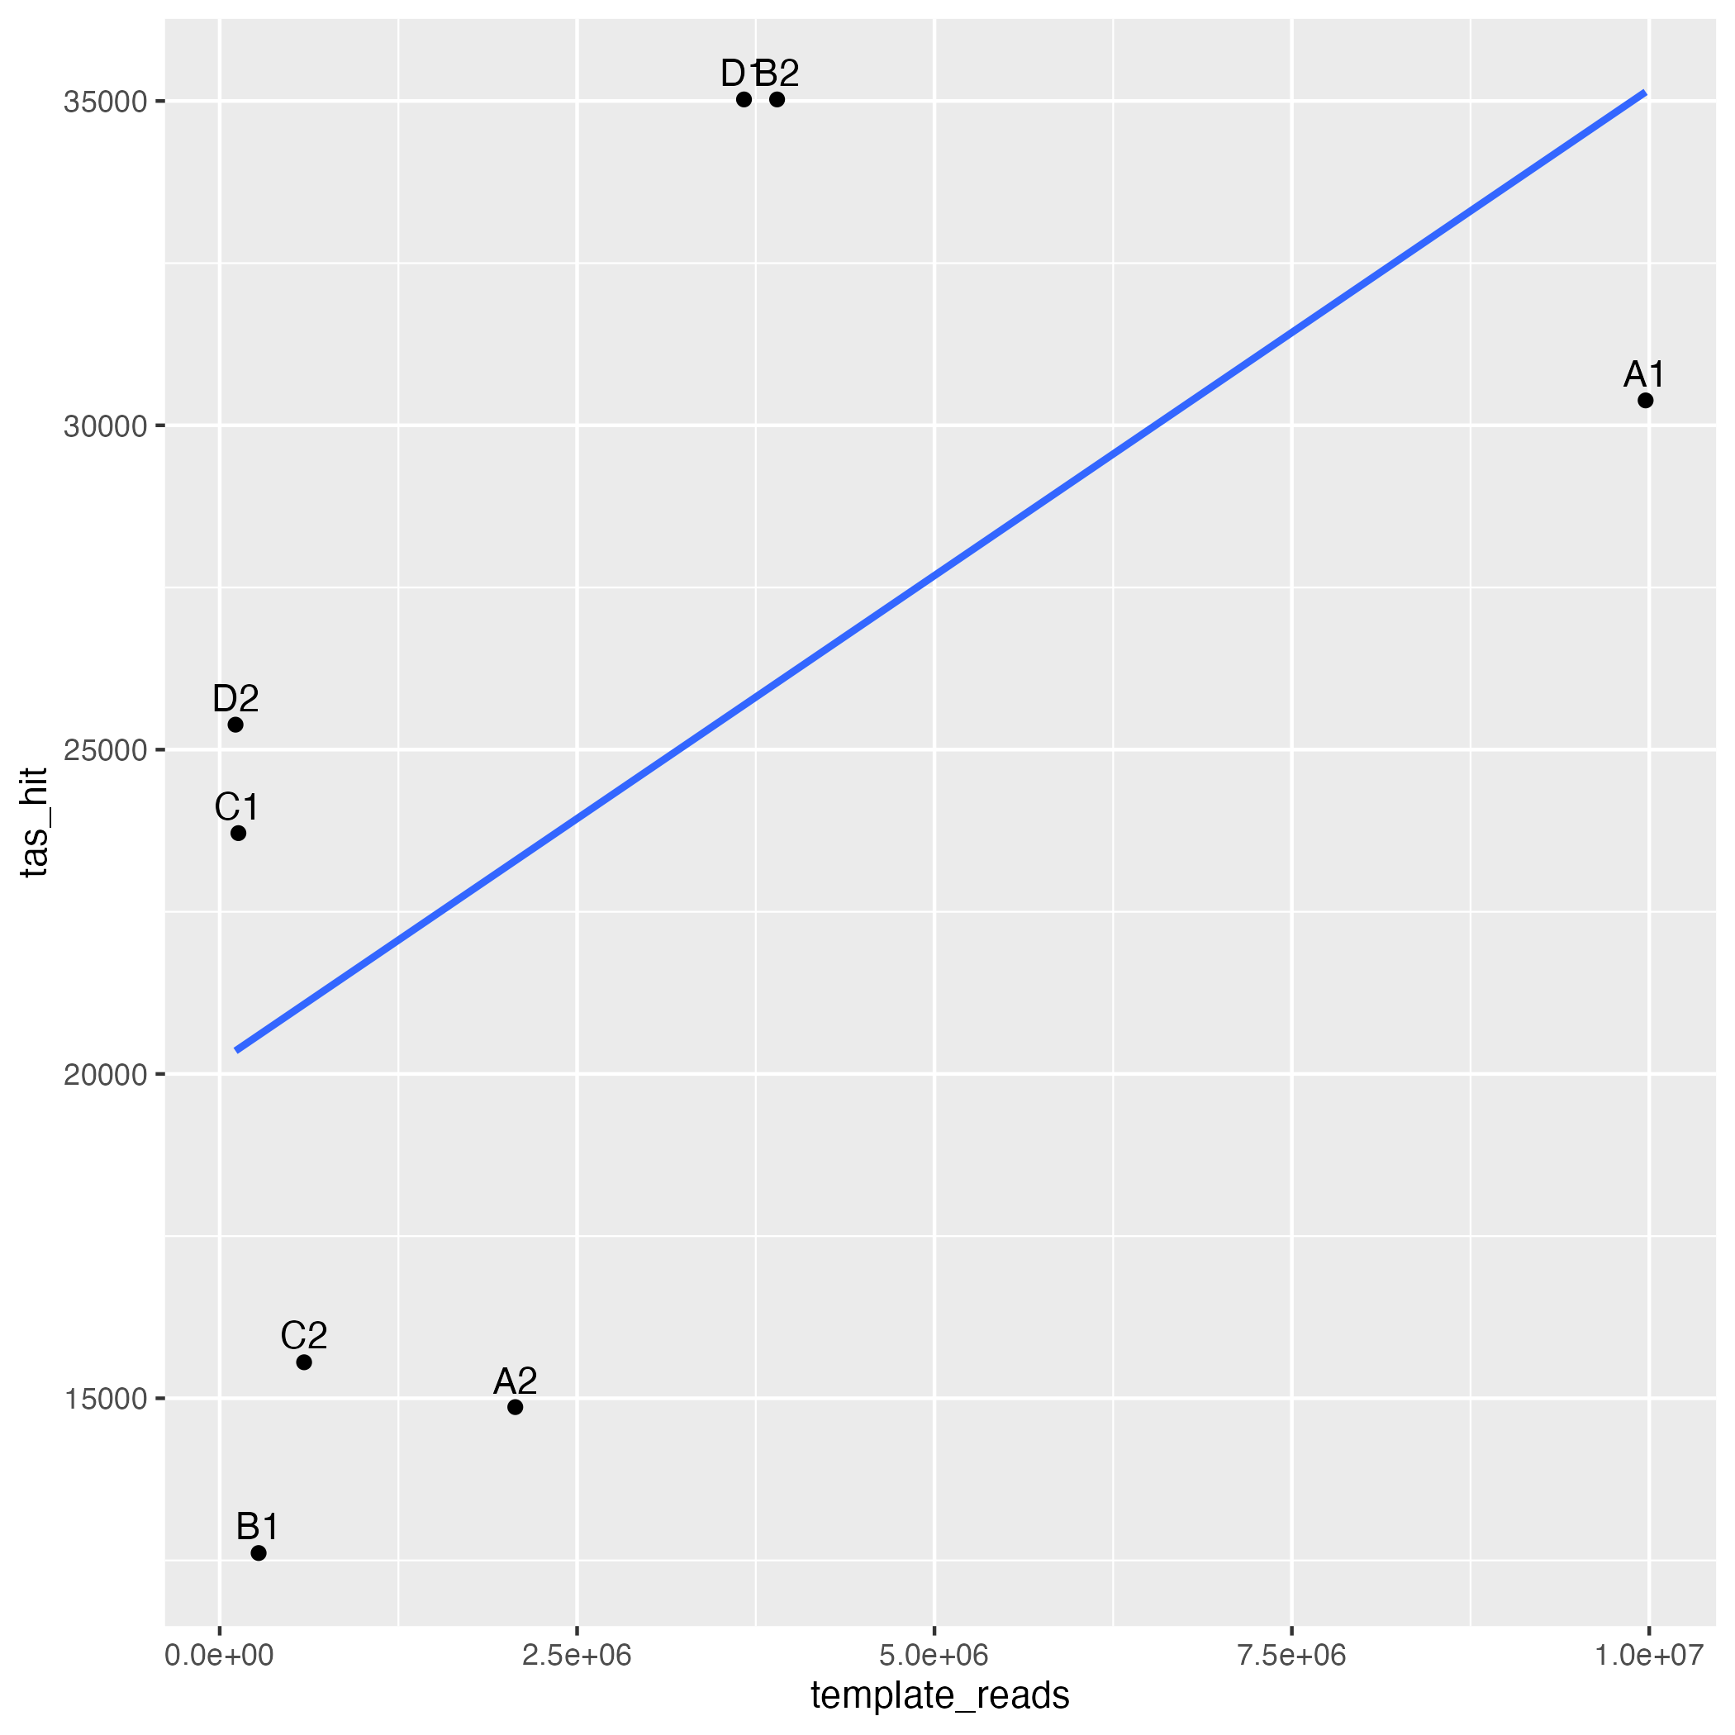
Reads vs TA’s hit
*C1, B1 and D2 had lowest amount of amplified transposon junctions in the pooled sample sent for sequencing

Slide 5
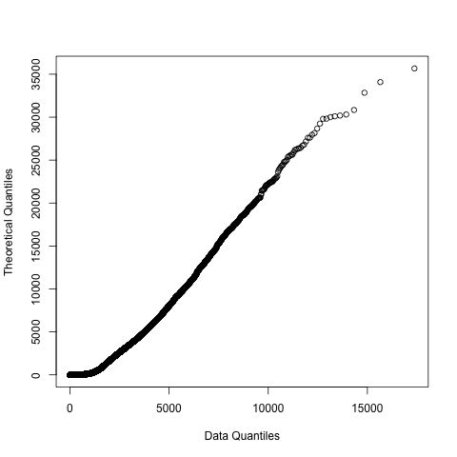
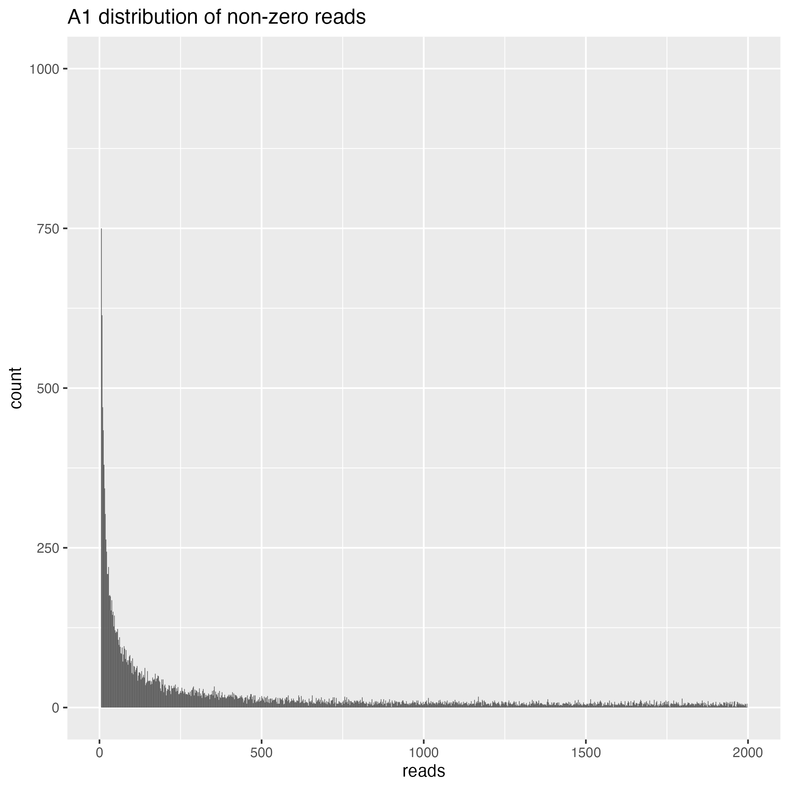
Read counts follow a geometric distribution

Slide 6
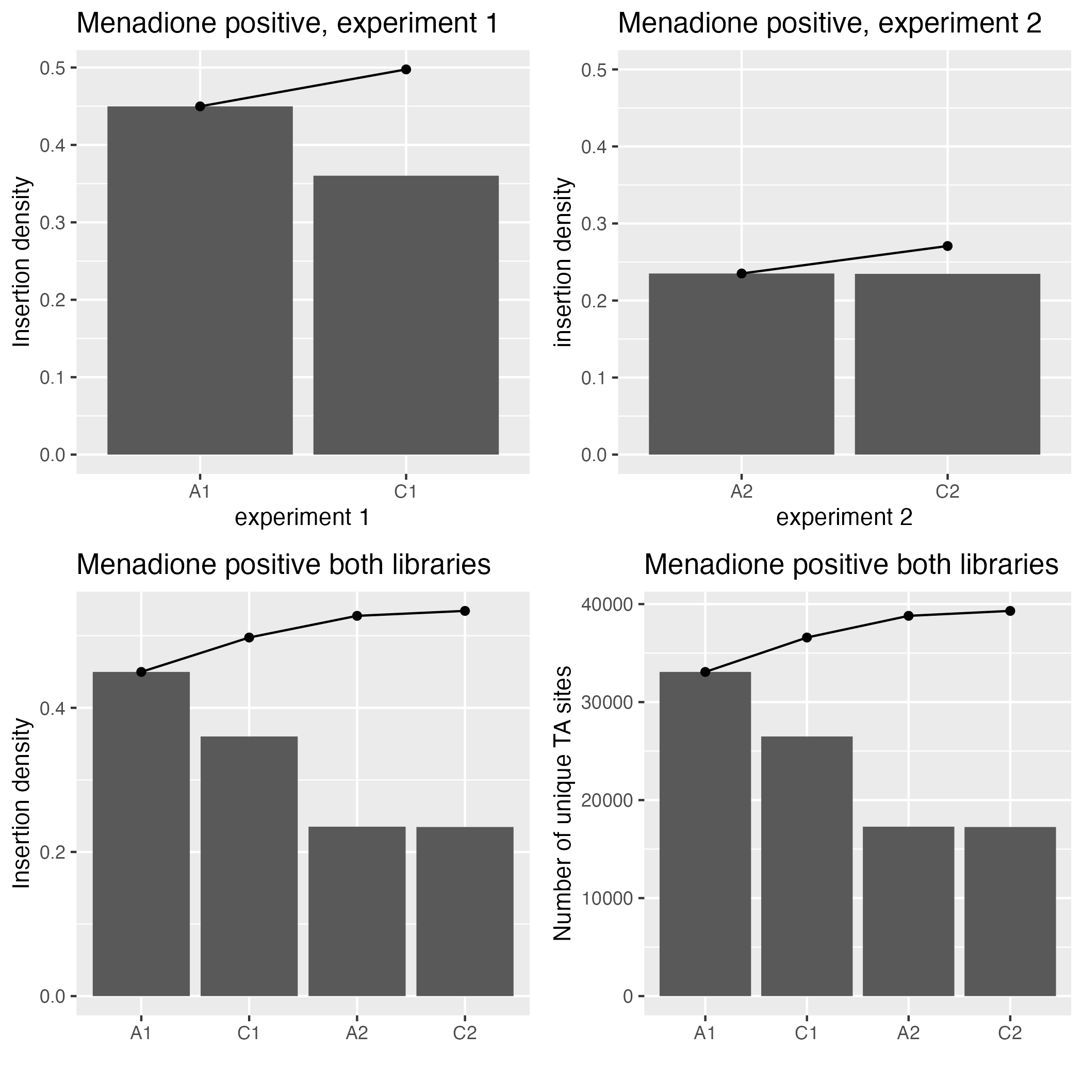
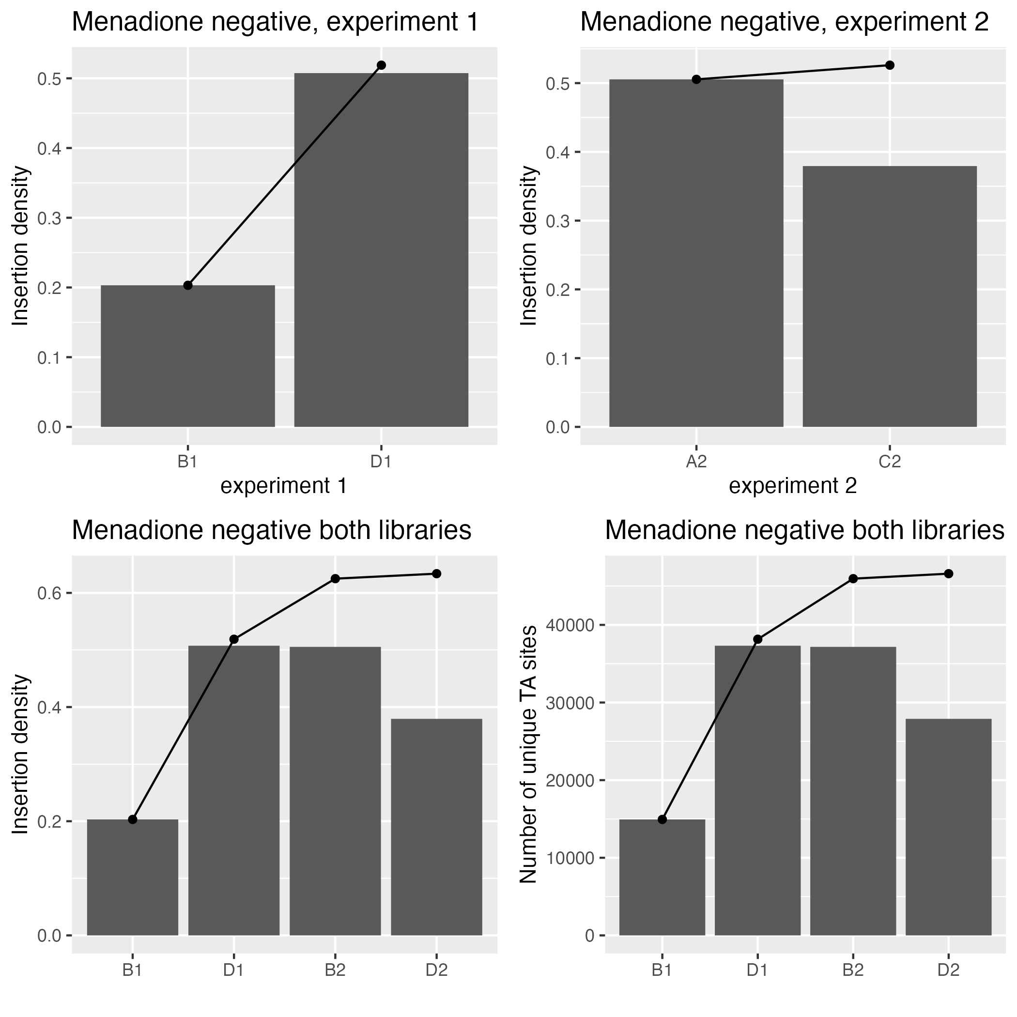
Cumulative insertion plots

Slide 7
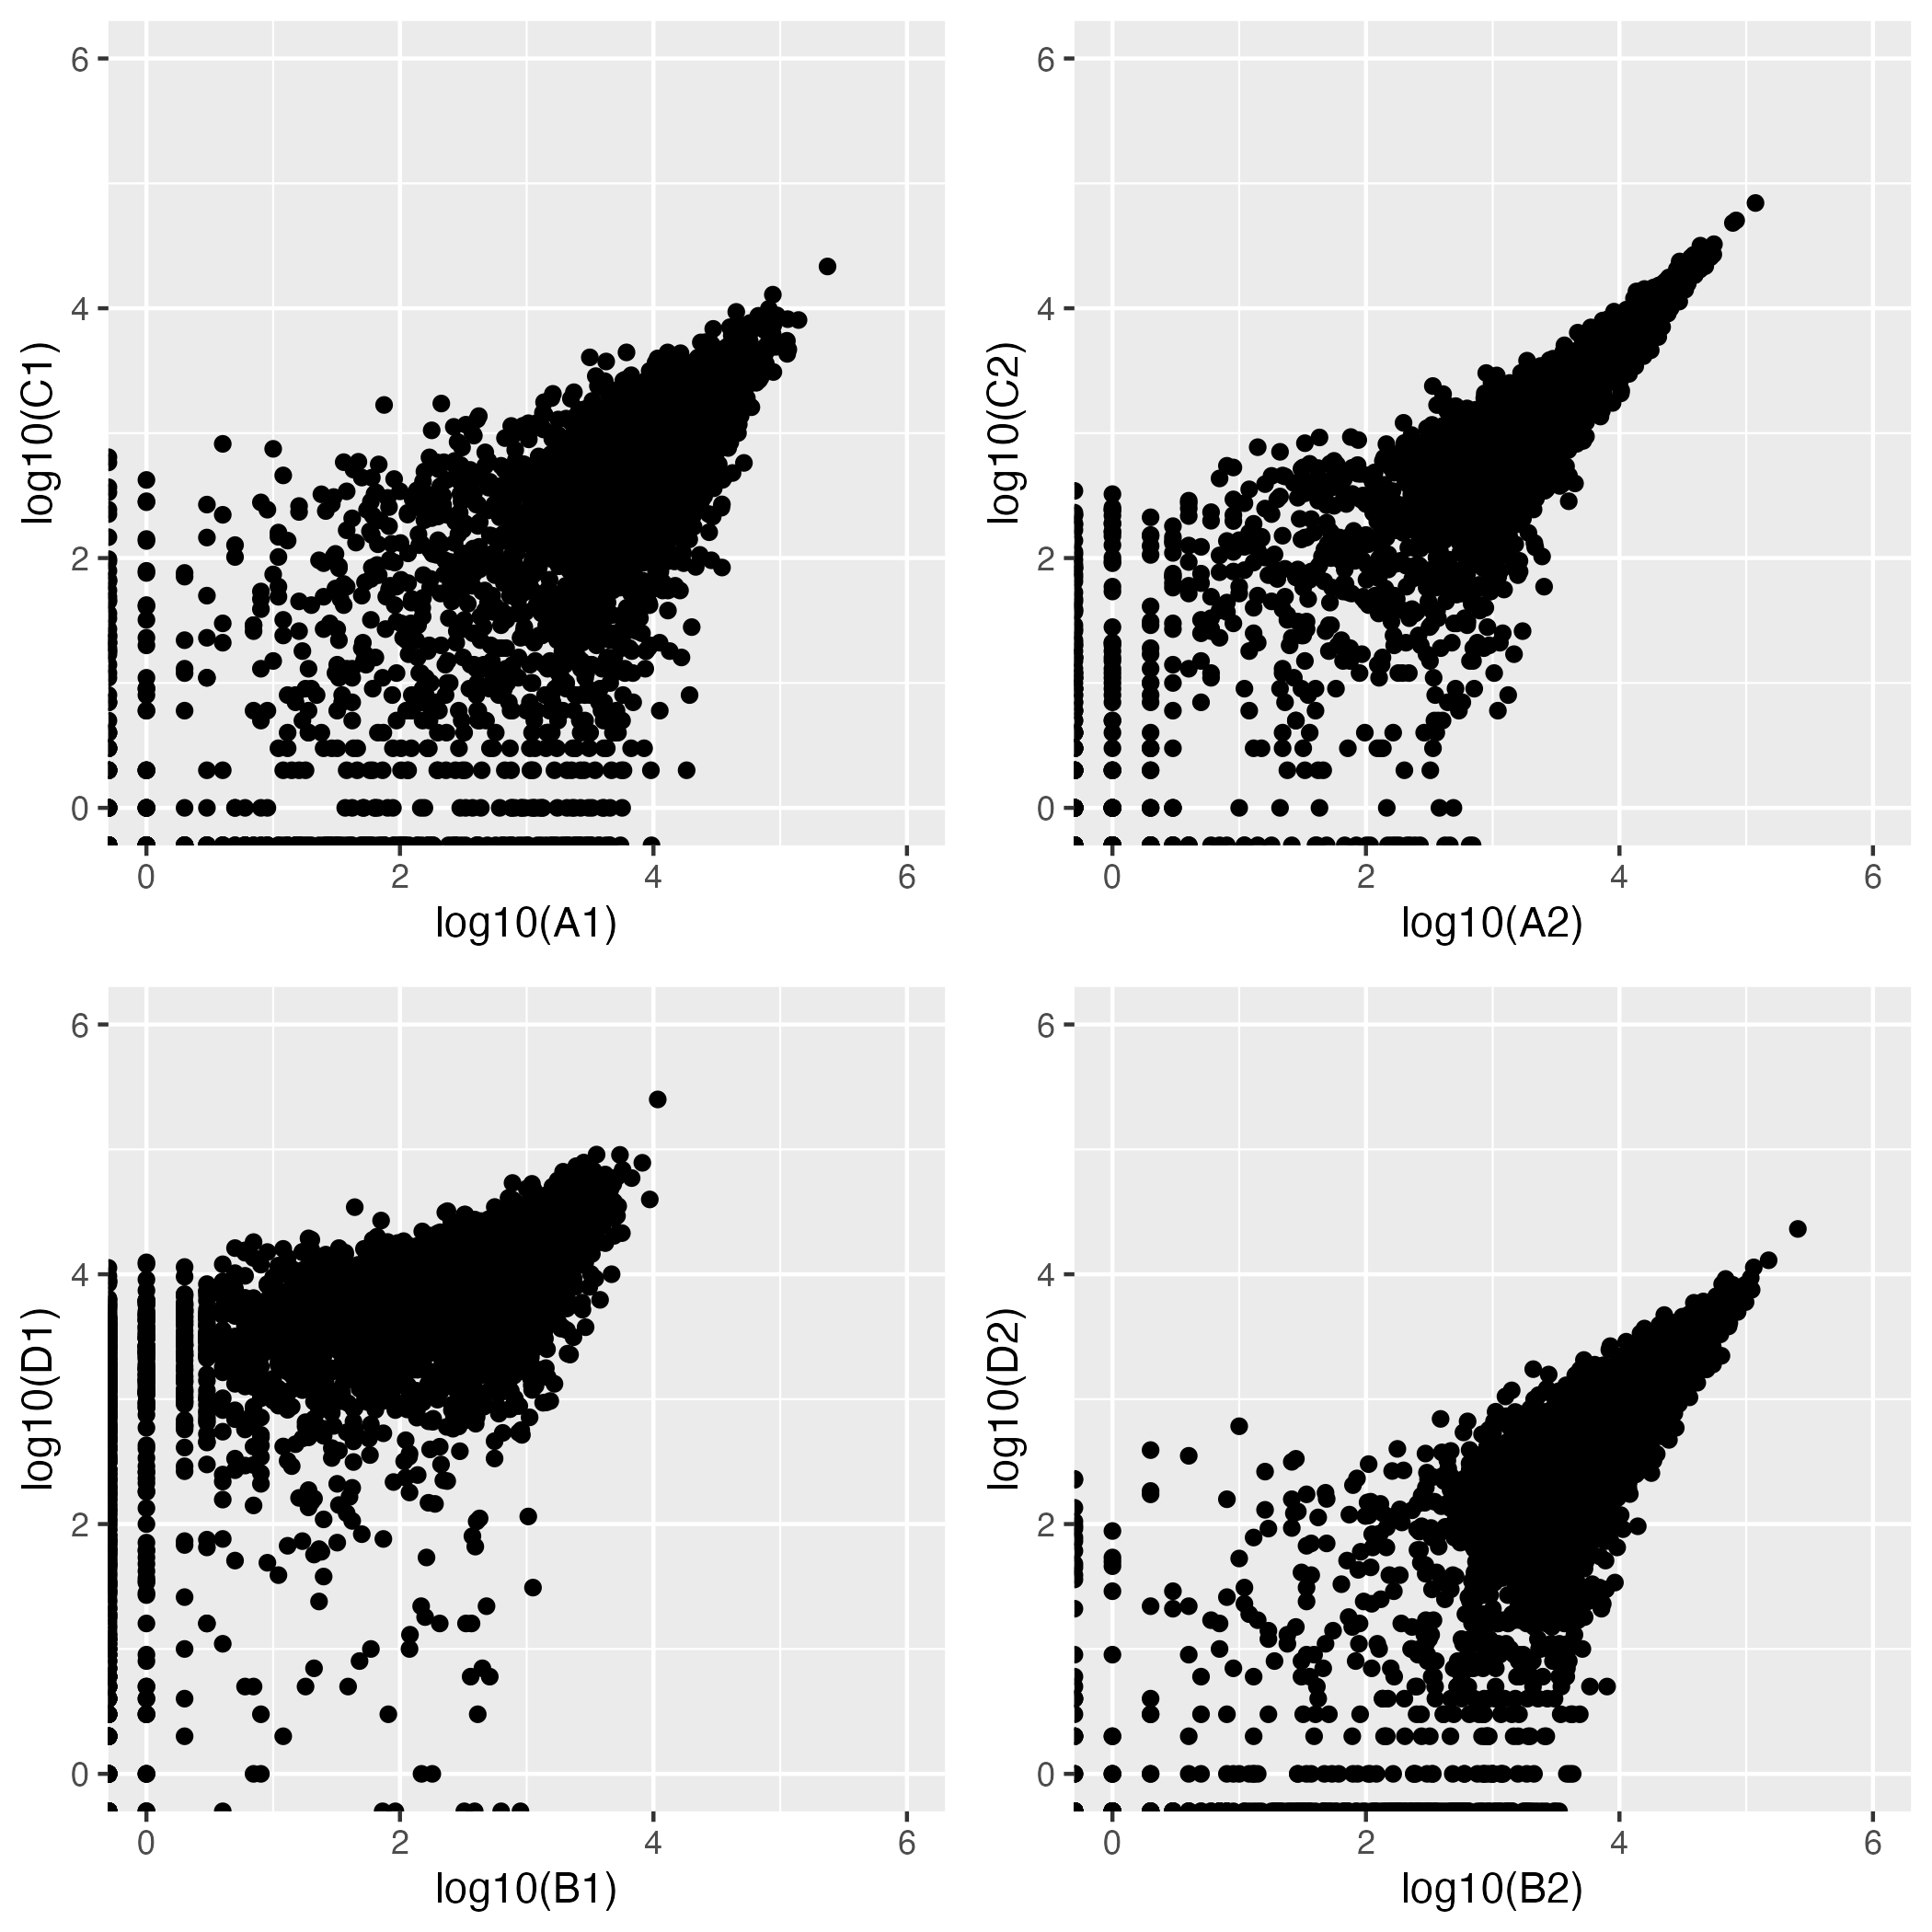
Correlation between replicates
Spearman’s correlation
A1:C1 0.68
A2:C2 0.89
B1:D1 0.52
B2:D2 0.76
All results of Welch Two Sample t-test indicate replicate samples could be from different populations (look like independent samples).
Correlation of reads at TA sites using log10 transformed read counts
Notes:
Differences in replicates most likely due to sampling differences when scraping plates and homogenizing cells to extract DNA, taking small portion of total gDNA for sequencing, shearing, technical errors making sequencing library, PCR jackpots (eliminated after the fact), etc.

Slide 8
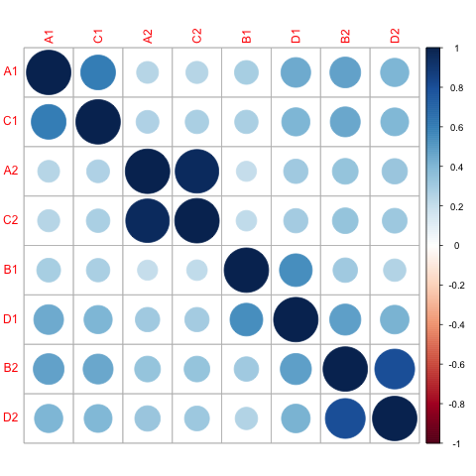
Corrplot of replicates and libraries (with Pearson’s correlation)

Slide 9
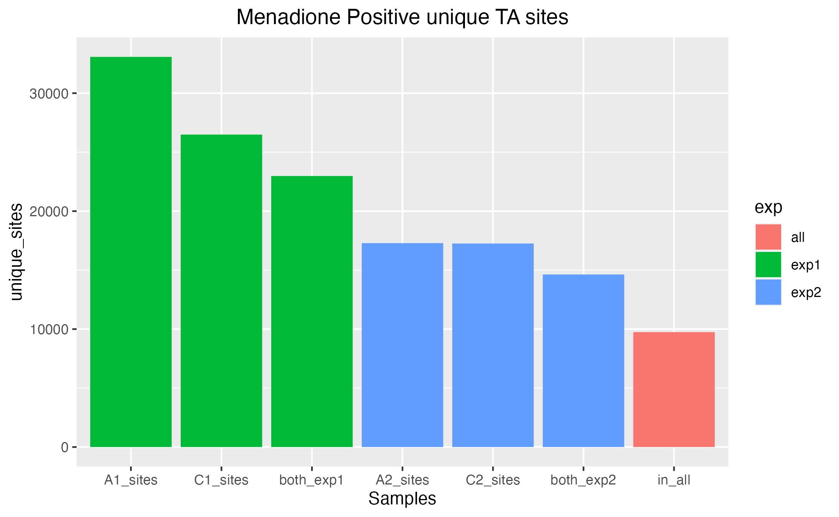
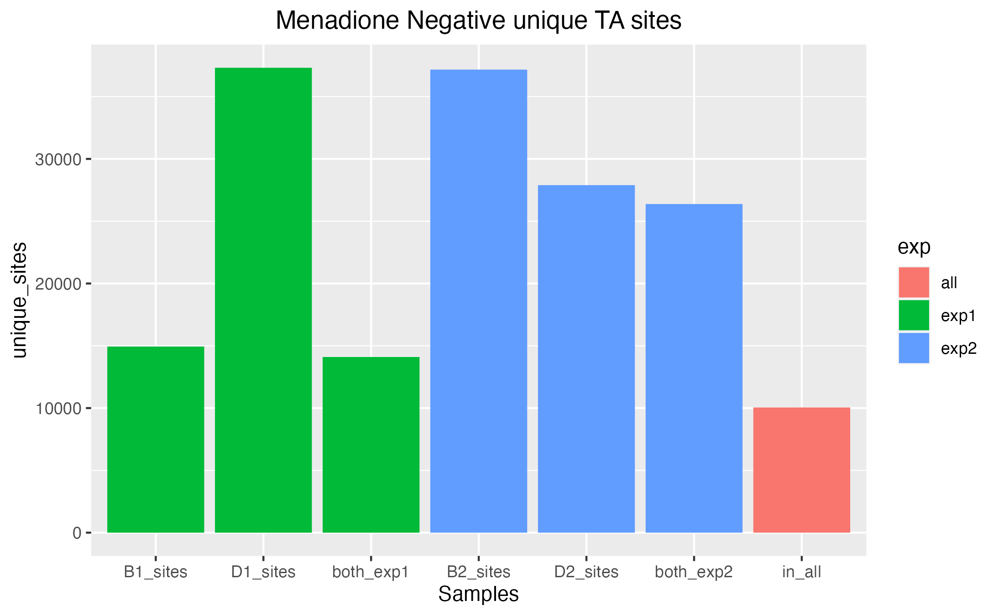
Unique TA sites in each sample/experiment
25% of unique TA’s hit are in all 4 positive samples
21% of unique TAs hit in all 4 negative samples
Notes:
Insertion counts at the same site in different libraries is expected to be uncorrelated because of so many sources of variation—indicates transposon insertion not influenced by insertion bias.

Slide 10
Experiment 2 has larger difference in mean between positive and negative conditions than experiment 1
Difference in pooled insertion densities between conditions:
Exp 1: 0.02 (2% difference)
Exp 2: 0.25 (25% difference)
Experiment 2 positive condition has lowest insertion density and consistent between reps. Both reps had >10M reads with transposon insertions found (good amplification of transposon junction) but very low diversity of insertion sites.
Possible reasons:
- bottleneck in sampling from positive library in experiment 2
- dominant clones in experiment 2 with much better survival
- experimental conditions actually different in exp 1 and exp2 positive cultures
Consequences:
- more false positives

Slide 11
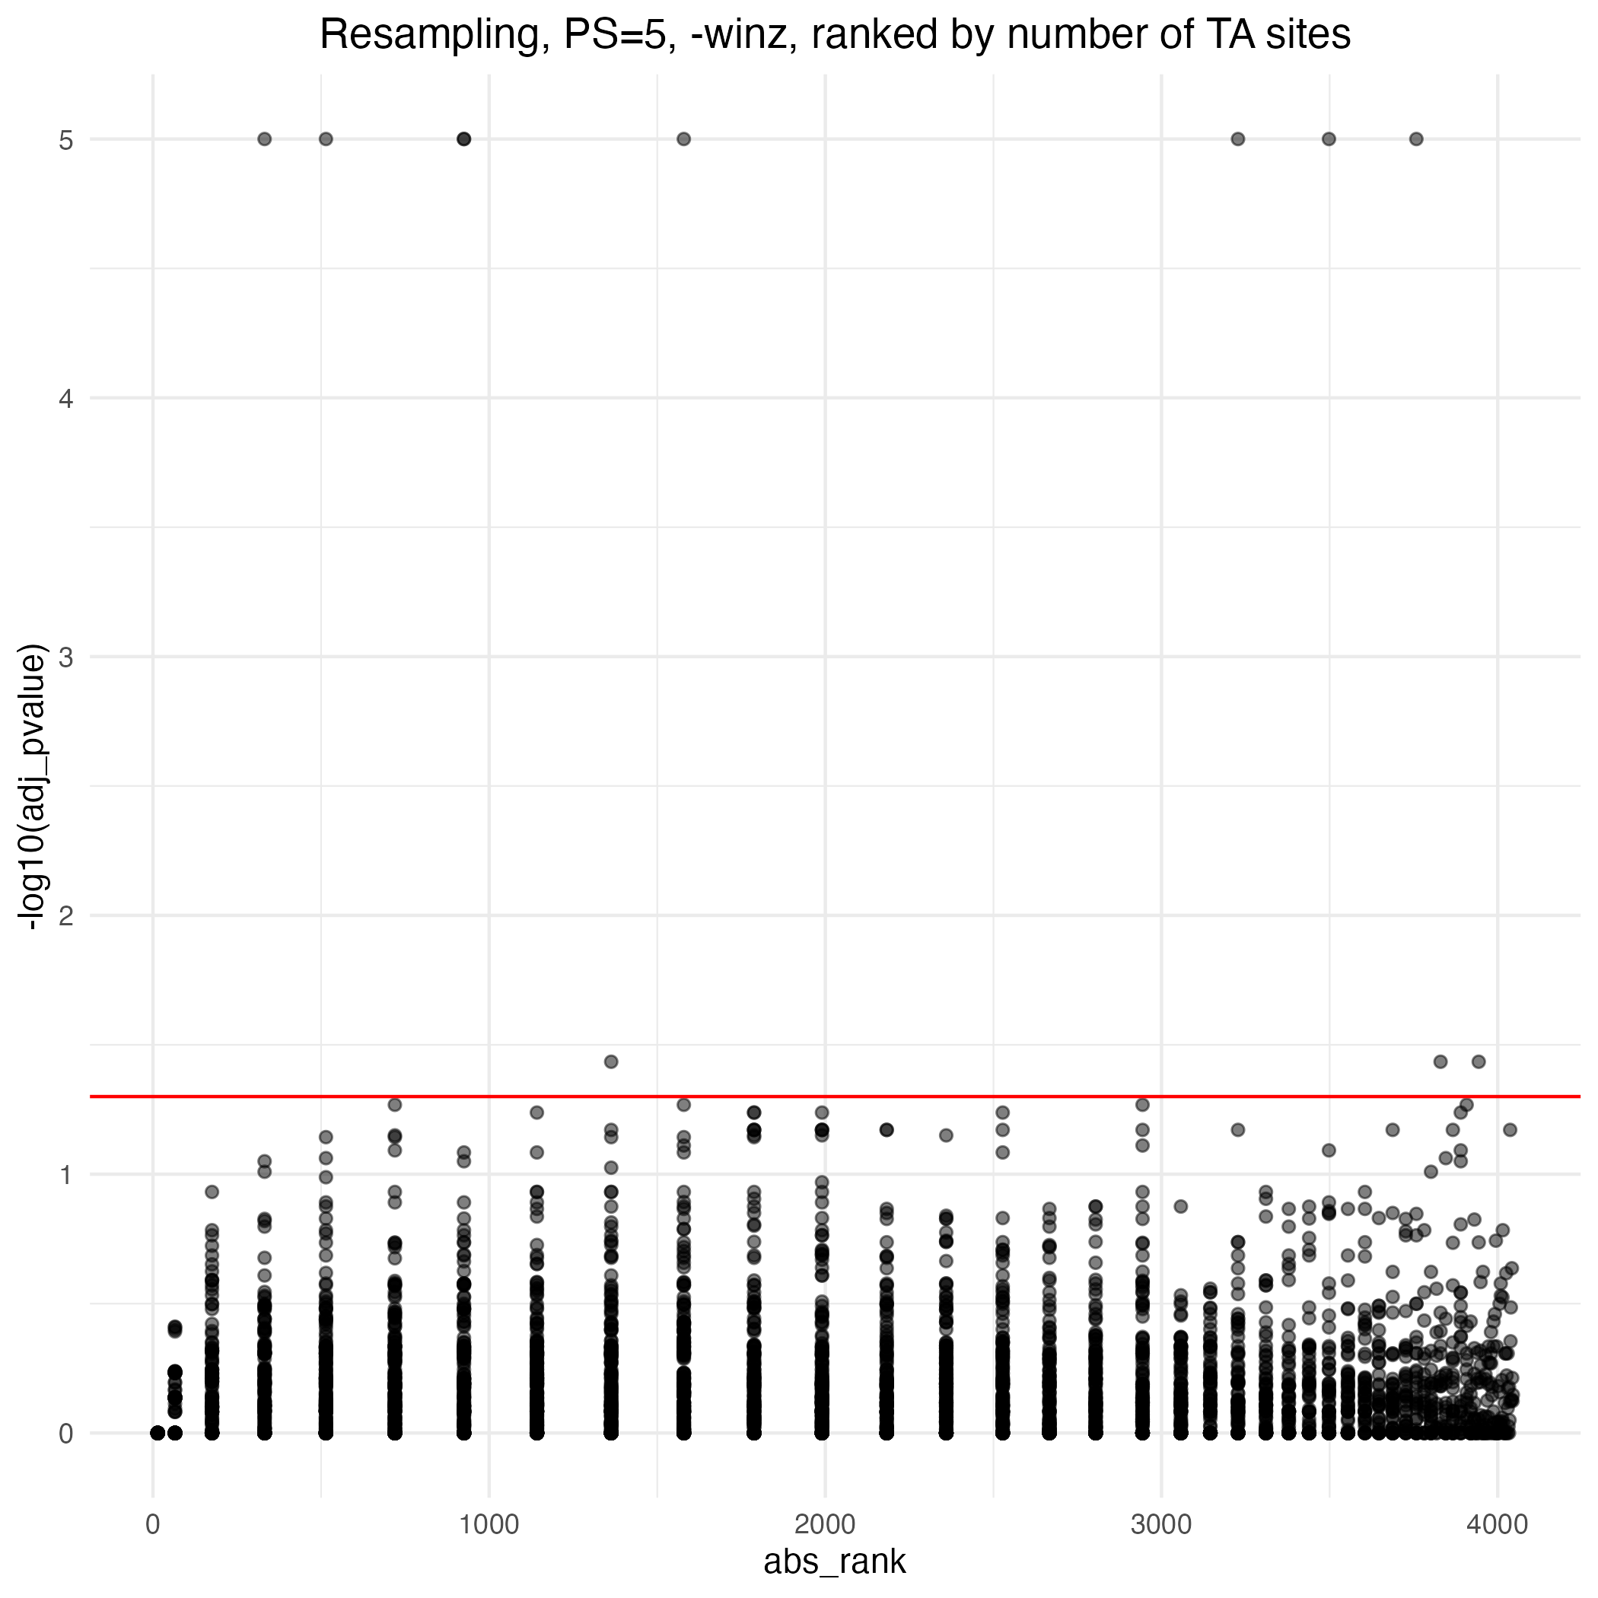
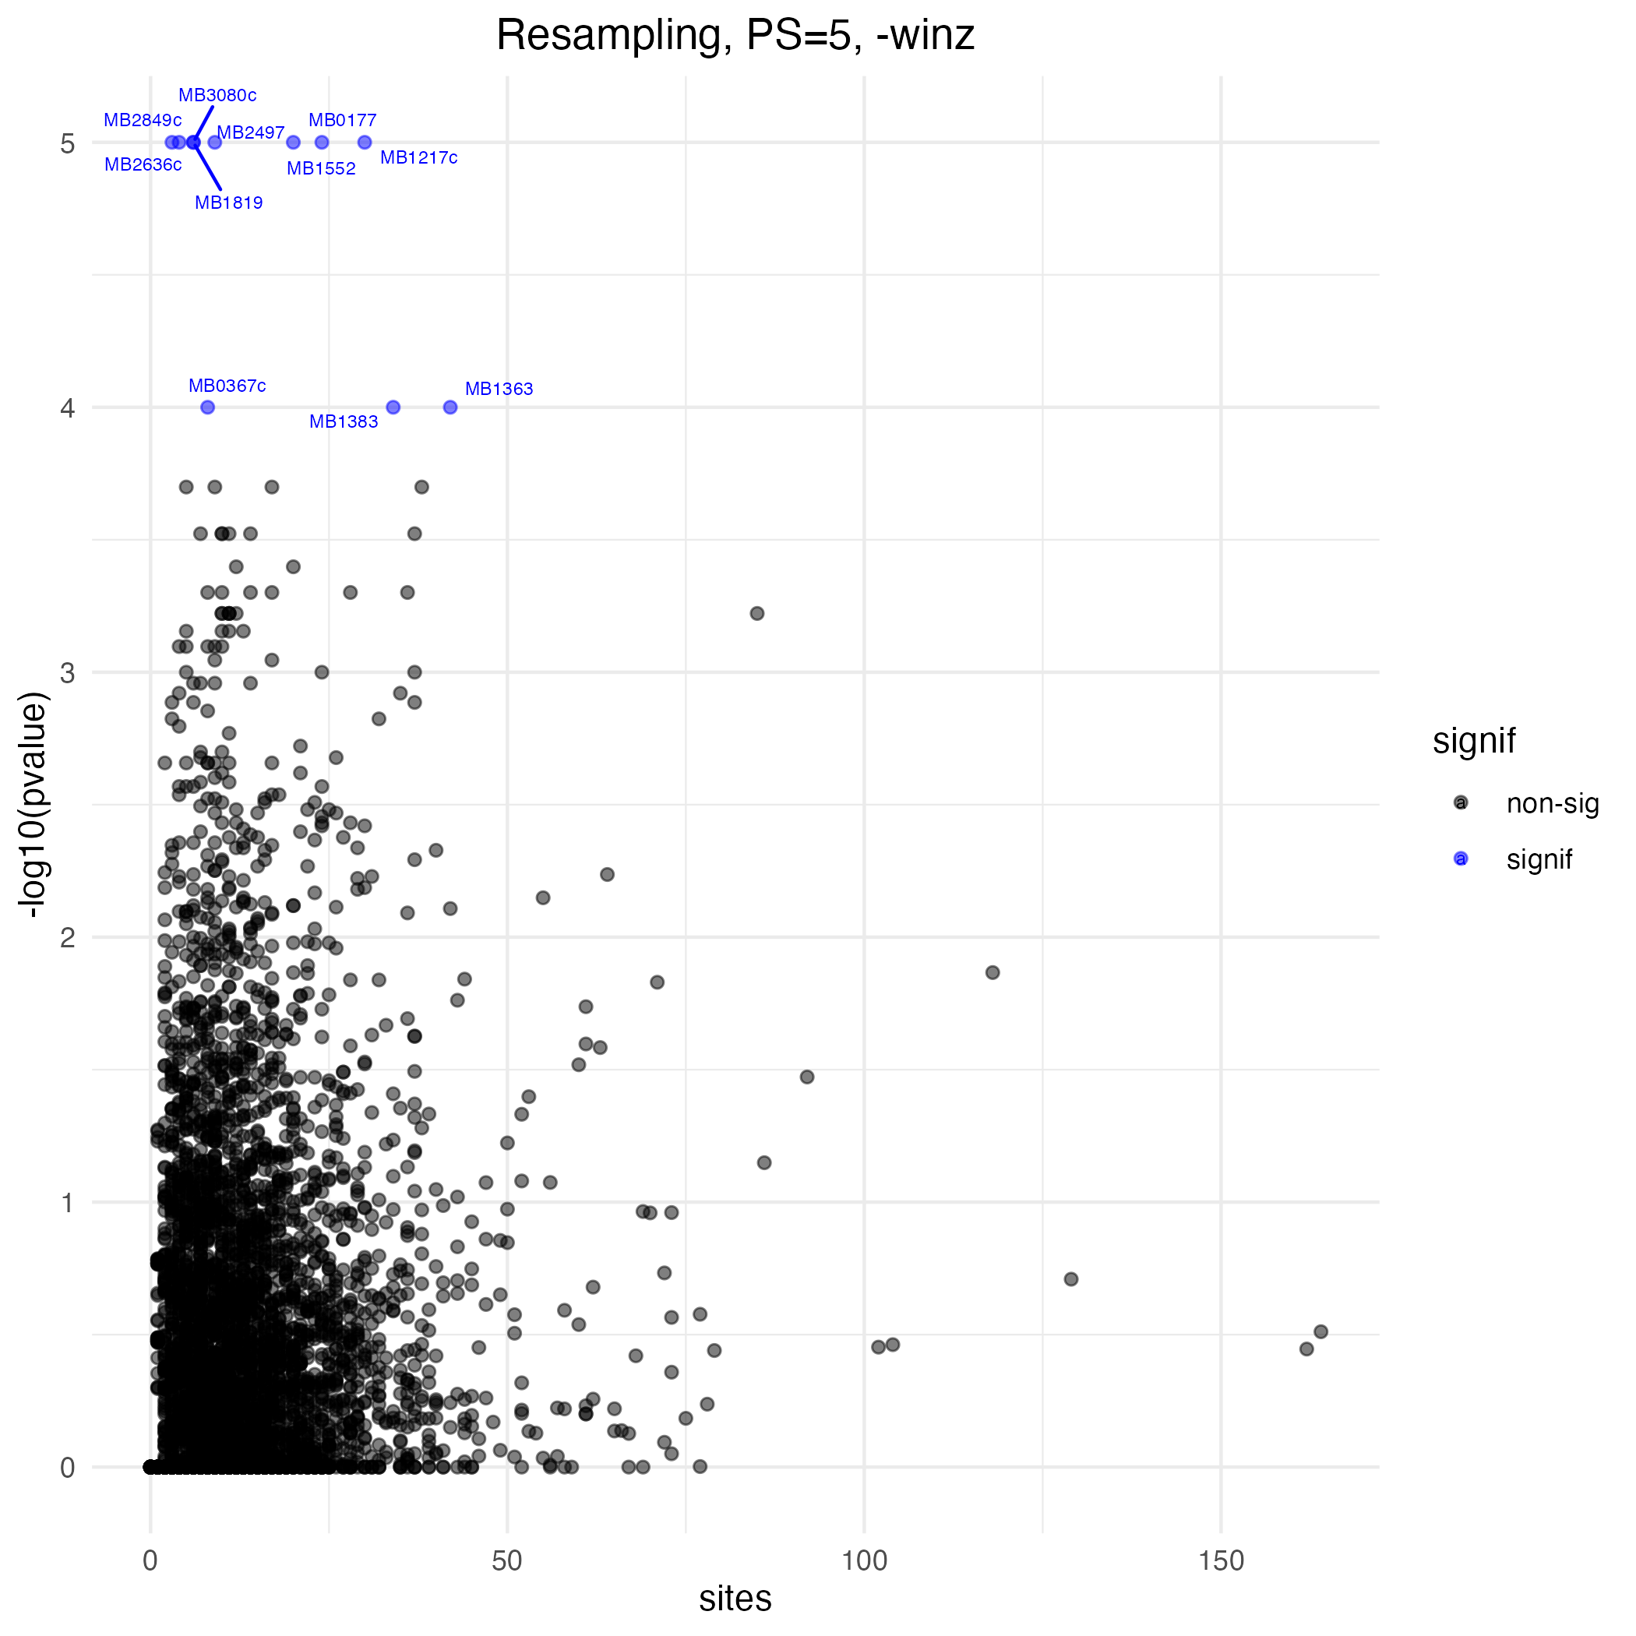
P-values vs TA sites
Min. 1st Qu. Median Mean 3rd Qu. Max.
0.00 6.00 10.00 12.47 16.00 158.00

Slide 12
TRANSIT HMM on each condition
Pooled all datasets as replicates (DeJesus et al, 2017 pools all libraries and runs HMM on ‘aggregated libraries’) using mean within transit HMM program.
Number of genes essential in both conditions: 375
Essential in positive only: 108
Essential in negative only: 80

Slide 13
Run Transit HMM on each library separately
essential in both conditions exp1: 391
number of essential genes in only positive: 106 number of essential genes only in men neg: 117
Essential in both conditions exp2: 344
number of essential genes in only positive: 225 number of essential genes only in men neg: 174
Reflects insertion density of particular condition in particular library. i.e. lower insertion density::increased number of essential genes
(negative more sparse in Exp 1, positive more sparse in Exp2)

Slide 14
For combined libraries, first remove non-permissive sites from analysis
Removed 6605 sites, equivalent to about 9% of TA sites
1293 non-permissive sites do have insertions
249 removed (‘non-permissive’) sites have a total of > 1000 reads summed across all the samples.
648 genes have one or more non-permissive TA site with at least 1 insertion/read:
NONE of these genes had a p-value of < 0.05 (and only one had less than 0.10) in the ‘non-removed’ results. The removal of these sites appears to have no effect on reaching the p-value threshold for these genes.

Slide 15
Resampling (default params) finds 8 genes that are attenuated in menadione positive (adj p-value <0.10)
ORF | name | desc | sites | mean_ctrl | mean_exp | log2FC | sum_ctrl | sum_exp | delta_mean | pvalue | adj_pvalue
MB2636c | snop | probable glutamine amidotransferase snop | 3 | 315.9 | 0.3 | -7.89 | 3791.1 | 4.06 | -315.6 | 0 | 0
MB2849c | NA | CONSERVED HYPOTHETICAL PROTEIN | 4 | 110.1 | 0.5 | -6.17 | 1761.3 | 8.75 | -109.5 | 0 | 0
MB1552 | wbbL2 | POSSIBLE RHAMNOSYL TRANSFERASE WBBL2 | 20 | 66.8 | 0.8 | -5.27 | 5346.3 | 60.39 | -66.1 | 0 | 0
MB2771 | NA | PROBABLE DEHYDROGENASE | 8 | 53.6 | 0.6 | -5.1 | 1716 | 18.91 | -53 | 1.00E-04 | 0.05056
MB1217c | fadD21 | probable fatty-acid-amp ligase fadd21 (fatty-acid-amp synthetase) (fatty-acid-amp synthase) | 30 | 126.7 | 3.4 | -4.87 | 15206.9 | 403.04 | -123.4 | 0 | 0
MB0177 | mce1C | MCE-FAMILY PROTEIN MCE1C | 24 | 113.5 | 3.4 | -4.71 | 10899.1 | 325.35 | -110.1 | 0 | 0
MB2497 | glbO | globin (oxygen-binding protein) glbo | 9 | 222.2 | 32.8 | -2.72 | 8000.7 | 1180.85 | -189.4 | 1.00E-04 | 0.05056
MB3496 | NA | 13E12 repeat family protein | 14 | 192.9 | 54.5 | -1.81 | 10801.1 | 3050.61 | -138.4 | 1.00E-04 | 0.05056
(5 are < 0.05 )

Slide 16
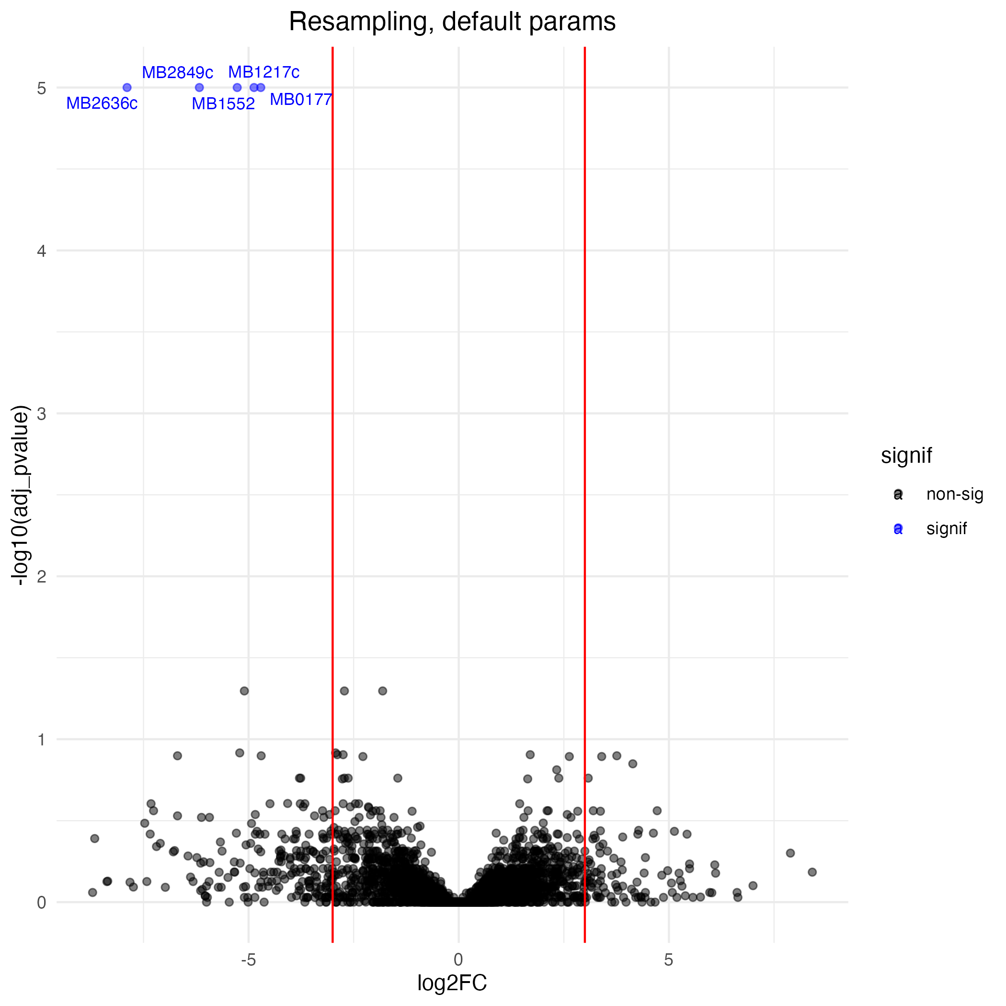
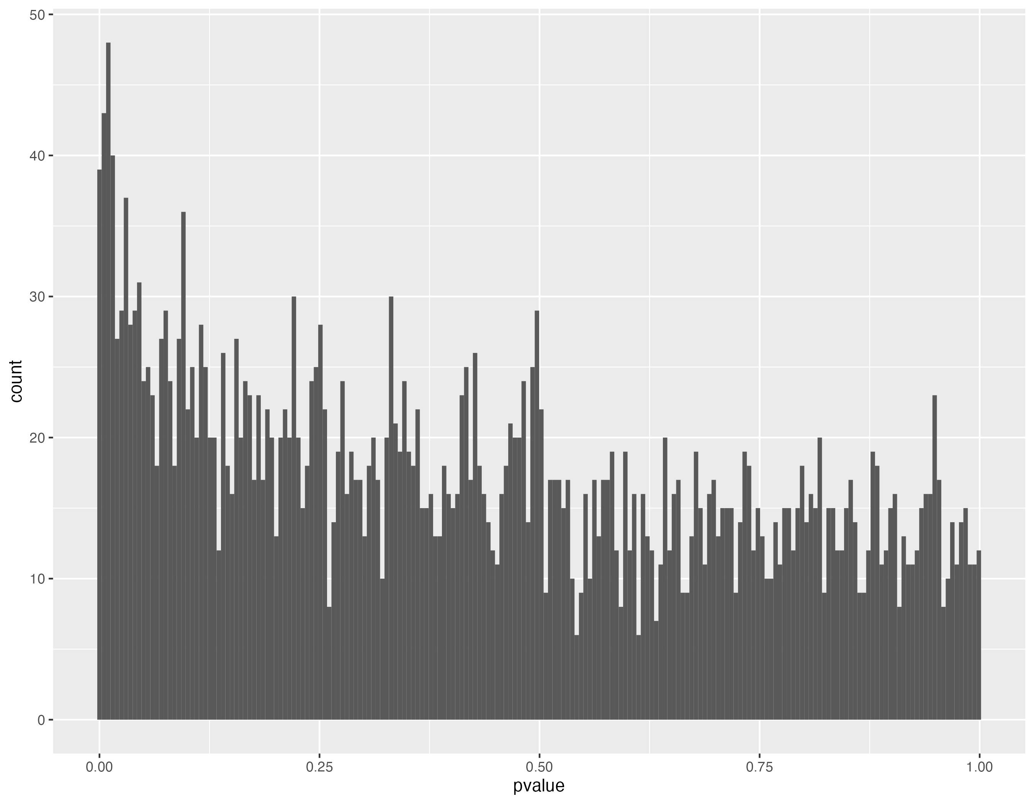
Resampling method distributions (distribution shows a lot of noise)

Slide 17
Running resampling multiple times gives some different hits (adj pval< 0.10)
Blue genes in common between 2 runs
Green < 0.05

Slide 18
Using Experiment 1 alone gives different hits but not more high-confidence hits (only 3 <0.05)
ORF | name | desc | sites | mean_ctrl | mean_exp | log2FC | sum_ctrl | sum_exp | delta_mean | pvalue | adj_pvalue
MB1123 | glyA1 | serine hydroxymethyltransferase 1 glya1 | 13 | 755.8 | 9.4 | -6.19 | 19651 | 243.8 | -746.4 | 2.00E-04 | 0.0809
MB1712c | NA | PROBABLE CONSERVED INTEGRAL MEMBRANE PROTEIN ABC TRANSPORTER | 13 | 148.6 | 2 | -5.66 | 3863.3 | 50.91 | -146.6 | 1.00E-04 | 0.05779
MB1552 | wbbL2 | POSSIBLE RHAMNOSYL TRANSFERASE WBBL2 | 22 | 36.2 | 1.5 | -3.89 | 1591.2 | 66.19 | -34.7 | 0 | 0
MB1566 | lspA | Probable lipoprotein signal peptidase lspA | 9 | 97.9 | 213.4 | 1.12 | 1761.8 | 3842.05 | 115.6 | 0 | 0
MB0067c | icd2 | PROBABLE ISOCITRATE DEHYDROGENASE [NADP] ICD2 (OXALOSUCCINATE DECARBOXYLASE) (IDH) (NADP+-SPECIFIC ICDH) (IDP) | 39 | 40.4 | 177.3 | 2.11 | 3150.6 | 13828.93 | 136.9 | 2.00E-04 | 0.0809
MB2507c | plsB2 | PROBABLE GLYCEROL-3-PHOSPHATE ACYLTRANSFERASE PLSB2 (GPAT) | 41 | 43.8 | 199.4 | 2.16 | 3591.3 | 16351.96 | 155.6 | 3.00E-04 | 0.10113
MB1346c | NA | POSSIBLE TRANSPOSASE [FIRST PART] | 6 | 56.9 | 338.4 | 2.55 | 682.8 | 4060.62 | 281.5 | 4.00E-04 | 0.10113
MB1548 | fadD25 | probable fatty-acid-amp ligase fadd25 (fatty-acid-amp synthetase) (fatty-acid-amp synthase) | 37 | 24.3 | 148.3 | 2.56 | 1798.9 | 10977.59 | 124 | 0 | 0
MB3827 | NA | PUTATIVE TRANSPOSASE [FIRST PART] | 6 | 57.6 | 344.2 | 2.56 | 691.5 | 4129.87 | 286.5 | 4.00E-04 | 0.10113
MB1363 | glgP | PROBABLE GLYCOGEN PHOSPHORYLASE GLGP | 45 | 41.1 | 253 | 2.59 | 3701.4 | 22766.52 | 211.8 | 1.00E-04 | 0.05779
MB1182c | NA | transcriptional regulatory protein | 9 | 87.4 | 737.9 | 3.06 | 1573.2 | 13282.28 | 650.5 | 4.00E-04 | 0.10113
MB2342c | NA | TldD family protein, Actinobacterial subgroup | 33 | 12.6 | 166 | 3.62 | 830.9 | 10953.88 | 153.4 | 4.00E-04 | 0.10113
MB0464c | echA2 | ENOYL-COA HYDRATASE ECHA2 (ENOYL HYDRASE) (UNSATURATED ACYL-COA HYDRATASE) (CROTONASE) | 11 | 33.9 | 496.7 | 3.83 | 746.3 | 10928.22 | 462.8 | 1.00E-04 | 0.05779
MB3520 | otsA | alpha, alpha-trehalose-phosphate synthase [udp-forming] otsa (trehalose-6-phosphate synthase) (udp-glucose-glucosephosphate glucosyltransferase) (trehalosephosphate-udp glucosyltransferase) (trehalose-6-phosphate synthetase) (trehalose-phosphate synthase) (trehalose-phosphate synthetase) (transglucosylase) (trehalosephosphate-udp glucosyl transferase) | 30 | 0 | 34.2 | 5.14 | 0 | 2050.12 | 34.2 | 1.00E-04 | 0.05779
MB2189c | rsmH | 16S rRNA (cytosine(1402)-N(4))-methyltransferase (EC 2.1.1.199) | 23 | 0 | 38 | 5.28 | 0 | 1746.46 | 38 | 2.00E-04 | 0.0809
MB0983 | NA | POSSIBLE MAGNESIUM CHELATASE | 15 | 6.6 | 349.6 | 5.53 | 198 | 10489.13 | 343 | 4.00E-04 | 0.10113
Blue signif in both whole results runs
Yellow <0.10 in results2
Uses new ‘site-restricted’ resampling method that does not require removing non-permissive sites. Supposed to be more sensitive…
Negative condition gained a lot more TA sites by including experiment 2. Without those sites getting more genes that look over-represented in positive condition. (see slides 2 and 5)

Slide 19
Adjust parameters of resampling method to be less sensitive to outliers and low insertion counts
ORF | name | desc | sites | mean_ctrl | mean_exp | log2FC | sum_ctrl | sum_exp | delta_mean | pvalue | adj_pvalue
MB0177 | mce1C | MCE-FAMILY PROTEIN MCE1C | 24 | 96.3 | 2.8 | -3.7 | 9243.3 | 266.89 | -93.5 | 0 | 0
MB0367c | NA | conserved protein | 8 | 217.1 | 24.5 | -2.91 | 6947 | 783 | -192.6 | 1.00E-04 | 0.03677
MB1217c | fadD21 | probable fatty-acid-amp ligase fadd21 (fatty-acid-amp synthetase) (fatty-acid-amp synthase) | 30 | 94.3 | 2.1 | -3.82 | 11313.7 | 246.01 | -92.2 | 0 | 0
MB1363 | glgP | PROBABLE GLYCOGEN PHOSPHORYLASE GLGP | 42 | 63.5 | 210.3 | 1.65 | 10671.5 | 35324.22 | 146.7 | 1.00E-04 | 0.03677
MB1383 | irta | iron-regulated transporter irta | 34 | 6.3 | 0.1 | -1.15 | 852.5 | 9.23 | -6.2 | 1.00E-04 | 0.03677
MB1552 | wbbL2 | POSSIBLE RHAMNOSYL TRANSFERASE WBBL2 | 20 | 64.6 | 0.4 | -3.68 | 5166.1 | 32.89 | -64.2 | 0 | 0
MB1819 | PE19 | pe family protein pe19 | 6 | 106.2 | 2.6 | -3.87 | 2549.7 | 62.15 | -103.6 | 0 | 0
MB2497 | glbO | globin (oxygen-binding protein) glbo | 9 | 217.3 | 30.1 | -2.66 | 7822.6 | 1084.78 | -187.2 | 0 | 0
MB2636c | snop | probable glutamine amidotransferase snop | 3 | 248.3 | 0.3 | -5.57 | 2979.5 | 4.06 | -248 | 0 | 0
MB2849c | NA | CONSERVED HYPOTHETICAL PROTEIN | 4 | 97.9 | 0.3 | -4.28 | 1567.1 | 4.87 | -97.6 | 0 | 0
MB3080c | NA | NADPH:quinone oxidoreductase | 6 | 143.3 | 1561.5 | 3.4 | 3438.5 | 37475.7 | 1418.2 | 0 | 0

Slide 20
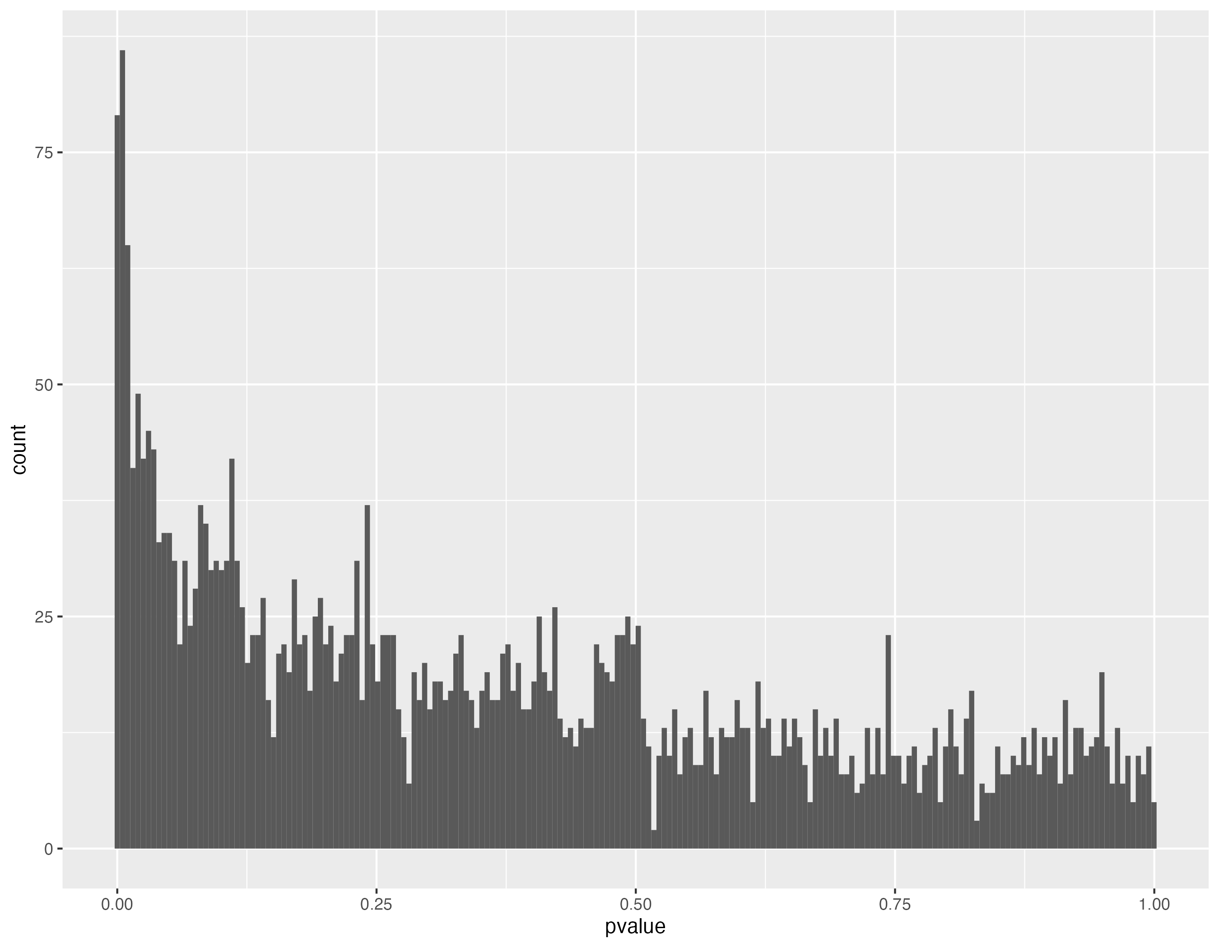
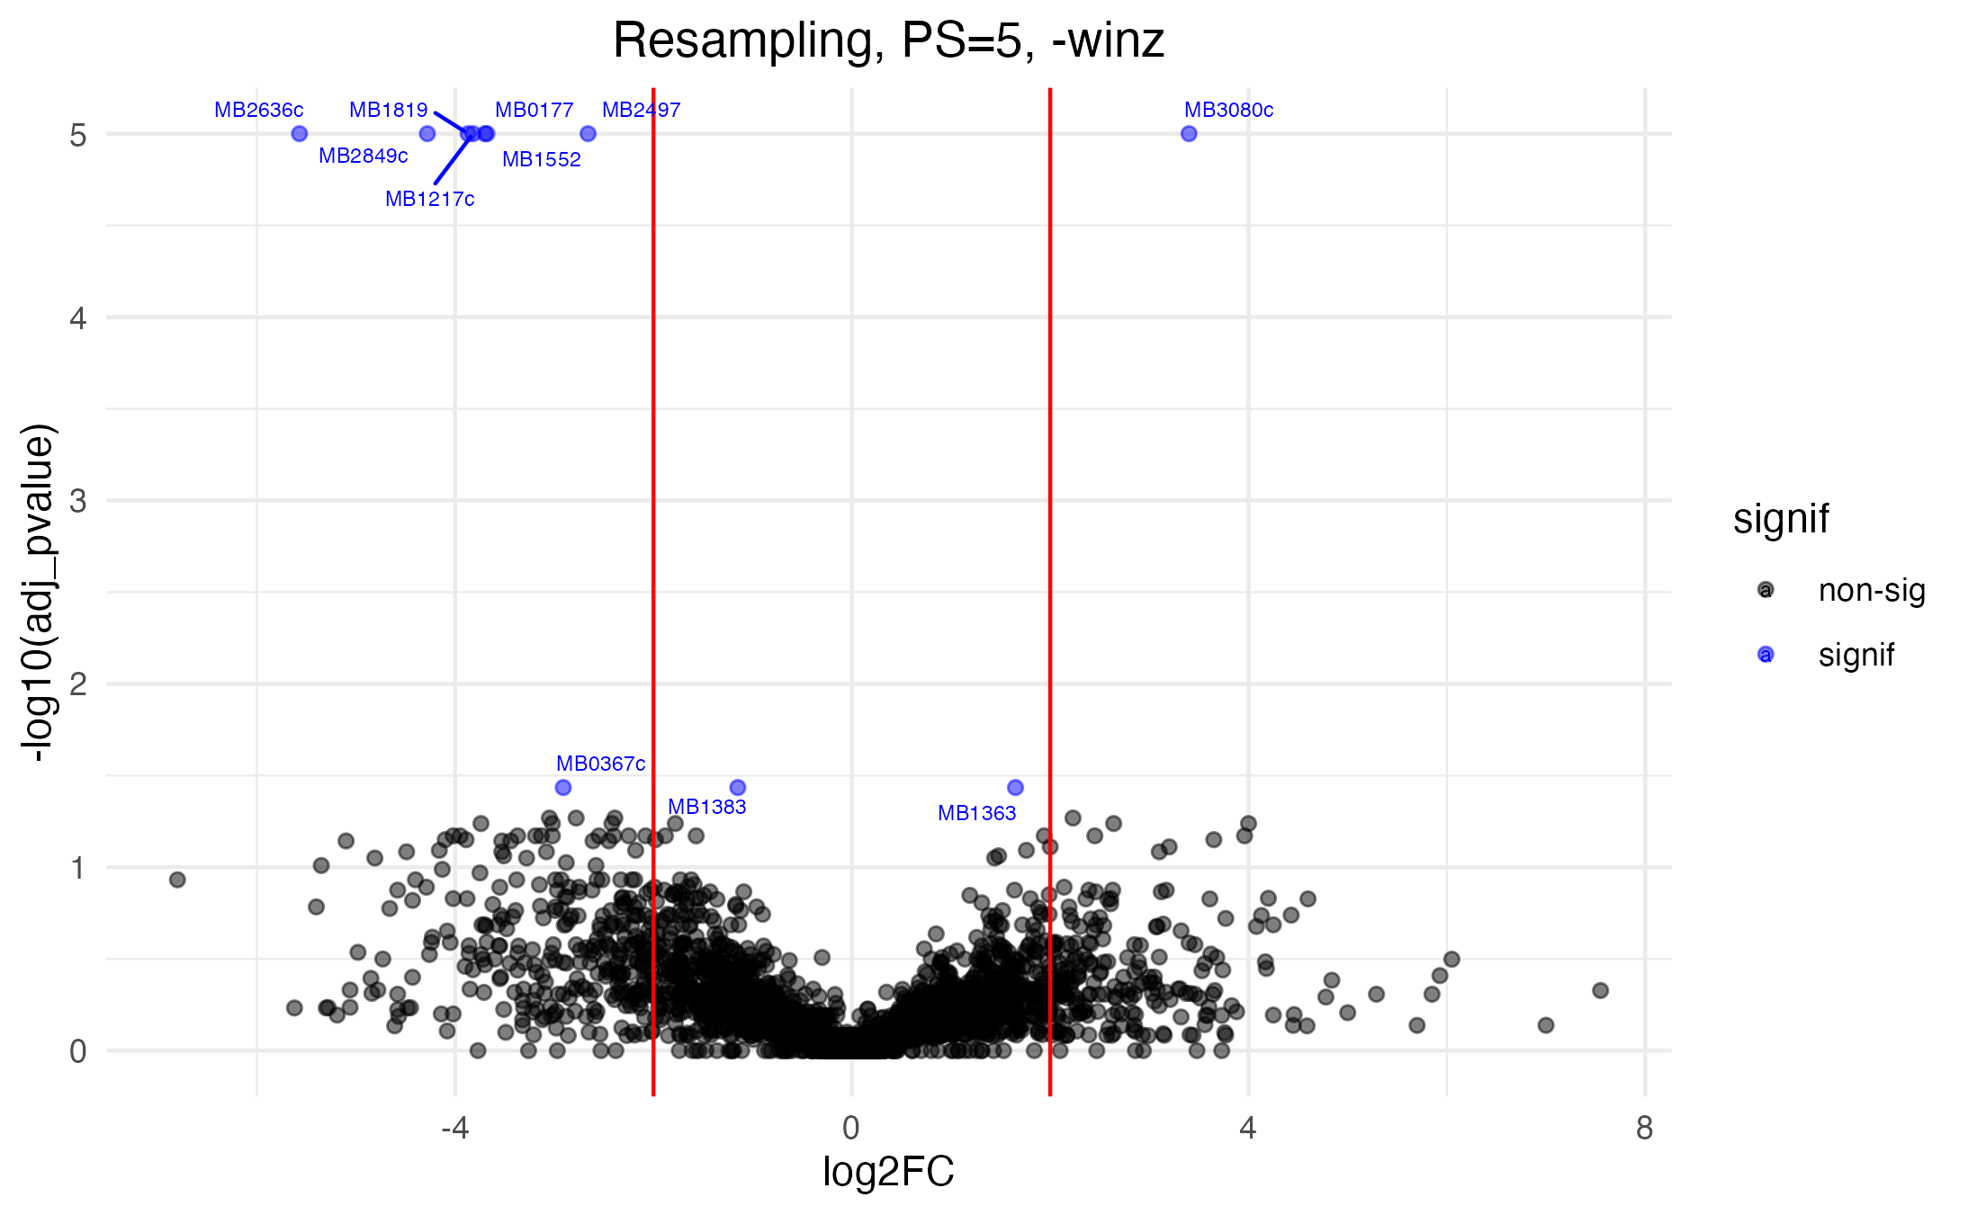
Distributions for resampling with winsorization and pseudocount=5

Slide 21
Non-parametric Mann-Whitney U-test
ORF | name | desc | sites | mean_ctrl | mean_exp | log2FC | u-stat | pvalue | adj_pvalue
MB2636c | snop | probable glutamine amidotransferase snop | 3 | 315.9 | 0.3 | -9.87 | 137.5 | 6.00E-05 | 0.01275
MB0183 | NA | PROBABLE CONSERVED MCE ASSOCIATED PROTEIN | 10 | 63.8 | 0.1 | -9.27 | 412.5 | 7.70E-04 | 0.0386
MB1040 | NA | HYPOTHETICAL PROTEIN | 4 | 203.2 | 0 | -7.67 | 120 | 0.00108 | 0.04569
MB2849c | NA | CONSERVED HYPOTHETICAL PROTEIN | 4 | 110.1 | 0.5 | -7.65 | 218 | 2.00E-04 | 0.02048
MB1552 | wbbL2 | POSSIBLE RHAMNOSYL TRANSFERASE WBBL2 | 20 | 133.7 | 1.5 | -6.47 | 1124 | 1.80E-04 | 0.02048
MB1383 | irta | iron-regulated transporter irta | 34 | 26.4 | 0.5 | -5.67 | 1131.5 | 5.00E-05 | 0.0122
MB1127c | NA | PROBABLE MEMBRANE GLYCINE AND PROLINE RICH PROTEIN | 17 | 152.7 | 3.8 | -5.32 | 740 | 3.70E-04 | 0.0291
MB2355 | PE23 | pe family protein pe23 | 12 | 280.1 | 17.7 | -3.98 | 1081 | 0.00118 | 0.04777
MB3458c | NA | HYPOTHETICAL PROTEIN | 10 | 258.4 | 16.6 | -3.96 | 731 | 0.00121 | 0.0481
MB1819 | PE19 | pe family protein pe19 | 6 | 109.7 | 7.1 | -3.94 | 449.5 | 3.00E-04 | 0.02714
MB2995 | NA | CONSERVED HYPOTHETICAL PROTEIN | 4 | 171.5 | 11.8 | -3.87 | 220.5 | 1.30E-04 | 0.01835
MB3520 | otsA | alpha, alpha-trehalose-phosphate synthase | 28 | 0 | 51.7 | 5.72 | 450 | 3.80E-04 | 0.0291

Slide 22
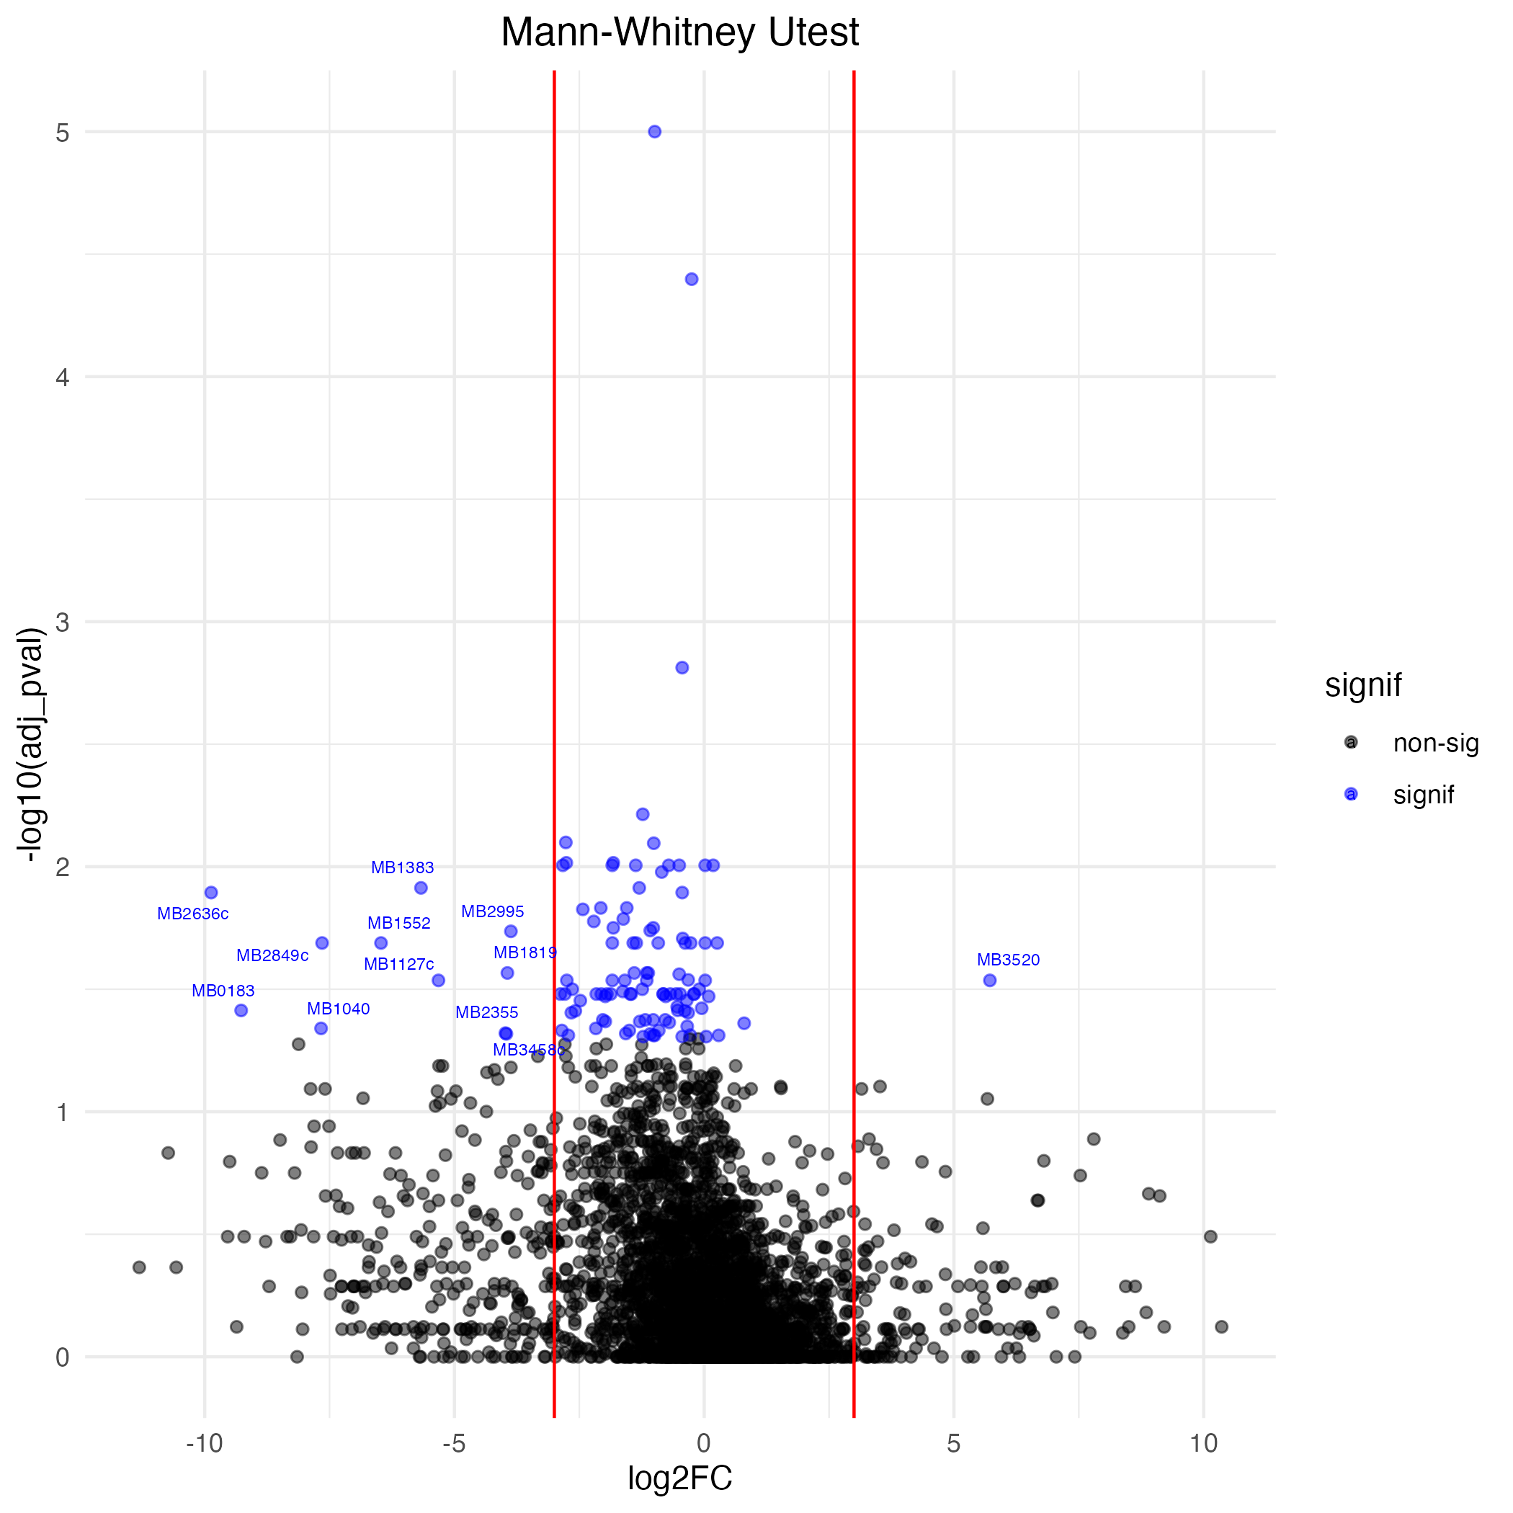
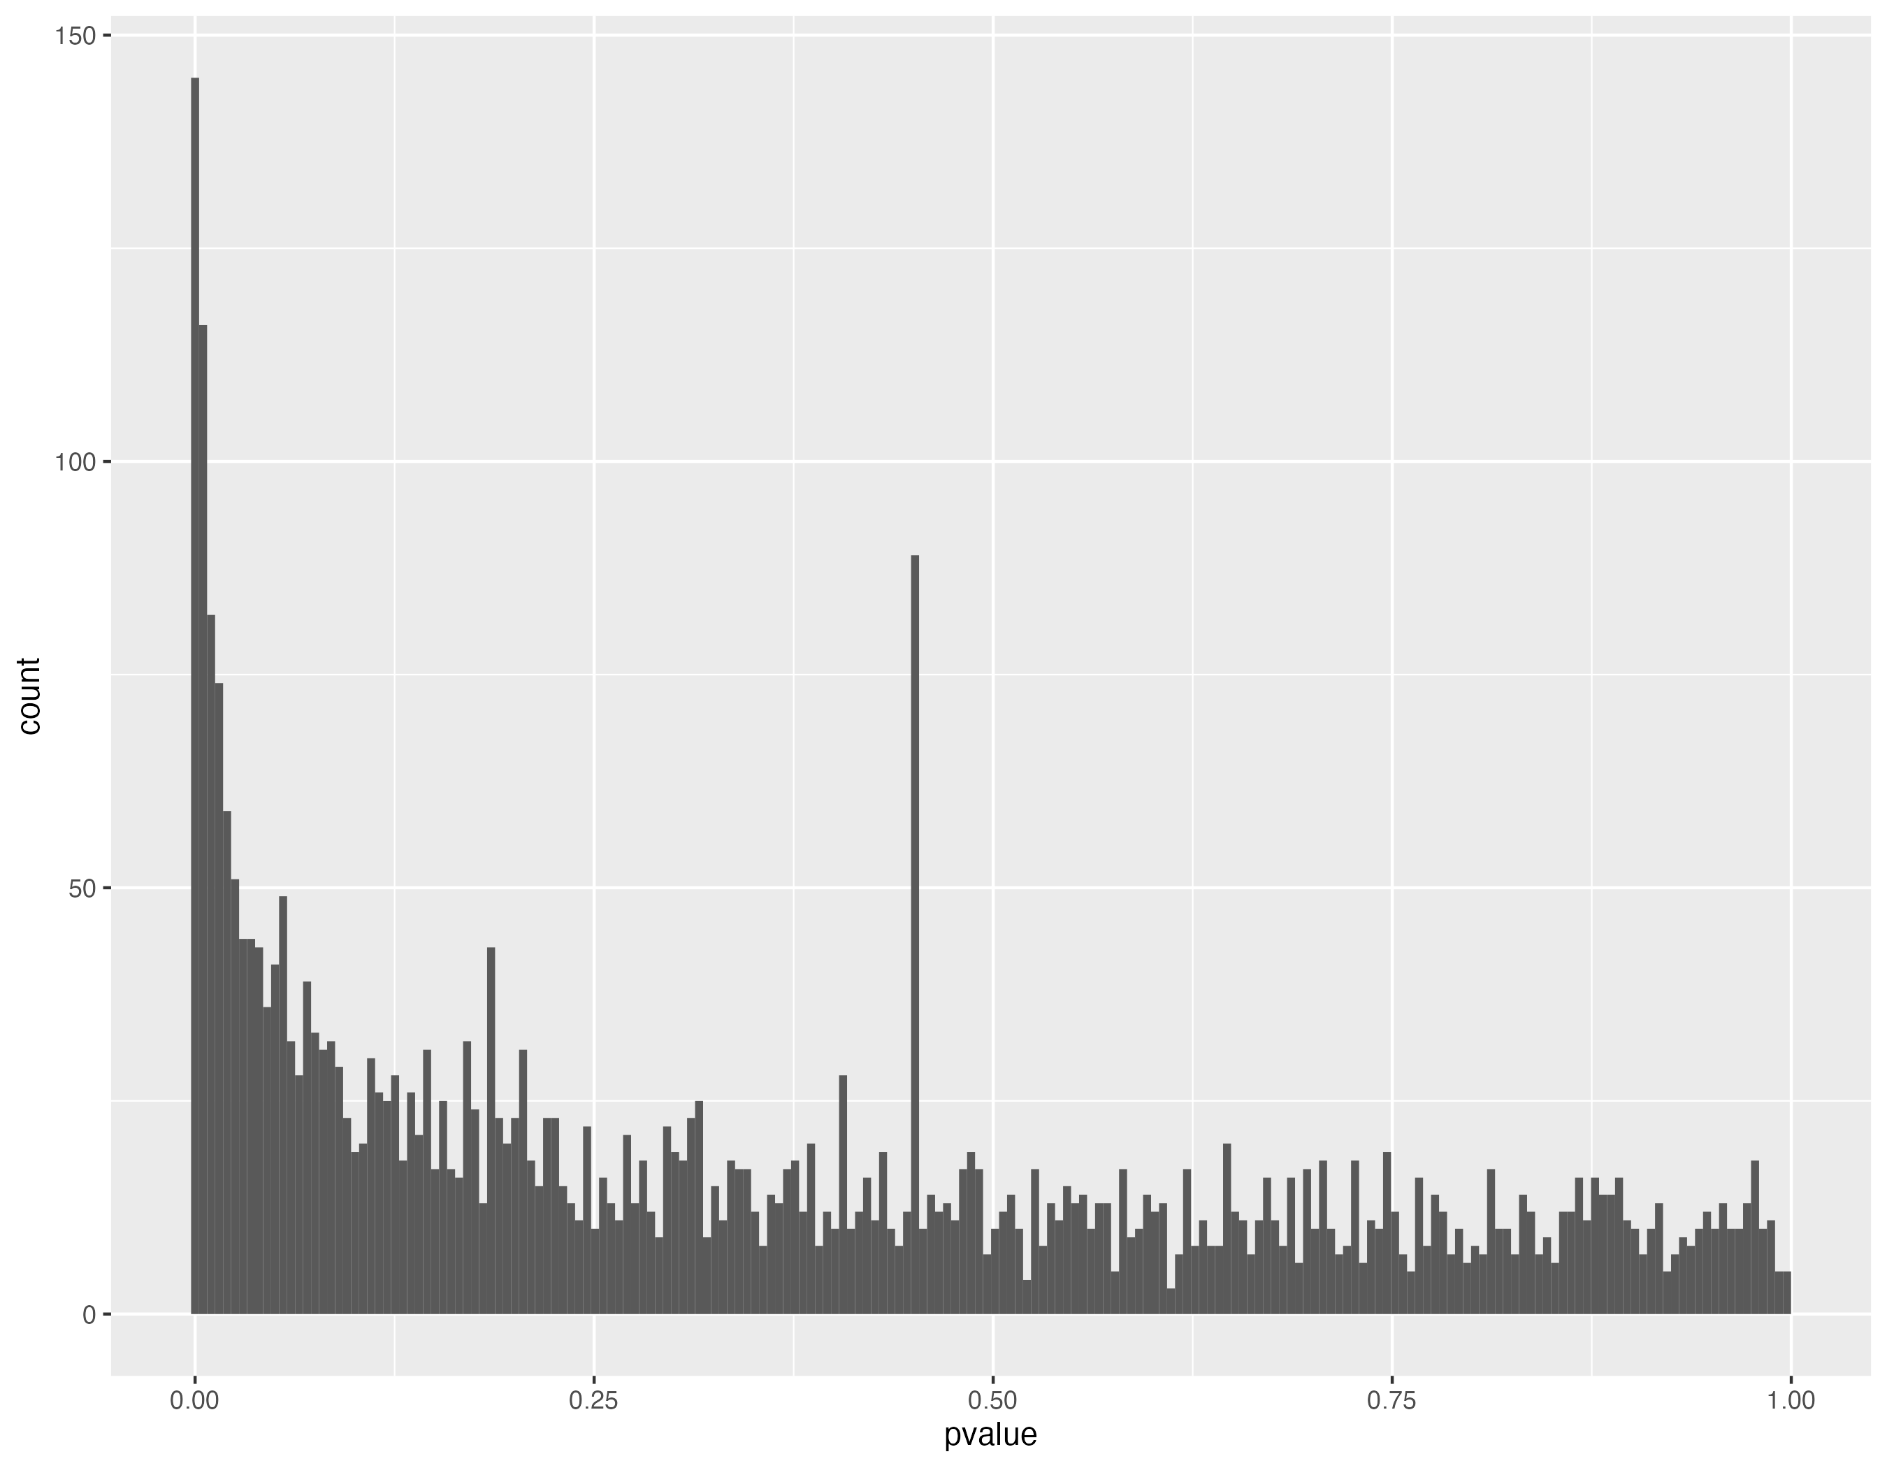
Distributions for Mann Whitney U-test (lower power—may be more susceptible to random error and outliers?)

Slide 23
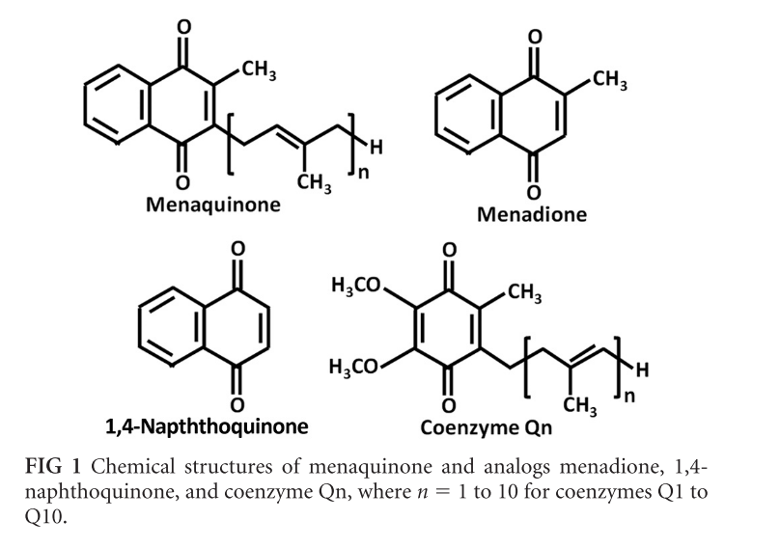
Menadione: menaquinone analog
Menadione excess known to cause increase in ROS (superoxide generator)
excess menaquinone is NOT antimicrobial, evidently, so is there an additional mechanism? (membrane disruption? EtBr uptake assays/sensitivity to SDS? Any phenotype?)

Slide 24
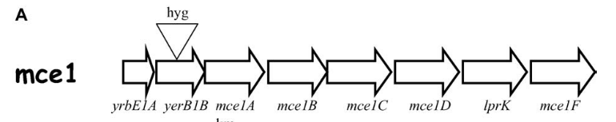
Mb0177 (Rv0171) Mce1c
99.8% identity in 515 aa overlap
Mce1c is part of a 13-gene operon, which can be polycistronic Rv0166-Rv0178 with 8-gene ‘core operon’ including Rv0167-Rv0174. (Casali et al., 2006, Jnl of Bacteriology).
Inactivation/deletion of entire mce1 operon (above) leads to less virulent mouse infection, though no growth inhibition (yrbE1B::hyg mutant with RT-PCR confirmation of no mce1B, mce1C expression) (Gioffré et al, 2005, Microbes and Infection)
Non-essential gene for in vitro growth of H37Rv, by analysis of saturated Himar1 transposon libraries (see DeJesus et al. 2017).
Required for growth in C57BL/6J mouse spleen, by transposon site hybridization (TraSH) in H37Rv (See Sassetti and Rubin, 2003). Required for survival in primary murine macrophages, by transposon site hybridization (TraSH) in H37Rv (See Rengarajan et al., 2005).
Non signif -log2FC in some animals, but pooled log2FC marginal. The rest of the ‘core’ operon (yrbE1A-mce1F) very attenuated with all but yrbE1A and mce1C reaching significance cutoff. All are attenuated in mice (bellerose, 2020)
mce1C is the only member of operon with SNPs (SYN) in WGS global collections of MTBC (Zwyer et al, 2021, Open Research Europe). These are at gene positions 390 for La1.6 (formerly Af1, West African group of pyrazinamide-susceptible Mbovis) and 1096 (unknown lineage, related to genomes from cervids in US).
TRANSIT-HMM: NE in negative and GD in positive, has 24 TA sites
Hub gene in midnightblue module (enriched in UTRs)

Slide 25
Mb0367c/Rv0360c Conserved hypothetical protein
TRANSIT-HMM: NE in both conditions
Has sigF binding consensus sequence and differentially regulated between ∆sigF stationary and WT biofilm (Dutta et al, 2019, Tuberculosis)
sigF regulates genes involved with oxidative stress response and cell wall synthesis/architecture
Hub in midnightblue module (same as mce1C)

Slide 26
MB1217c (Rv1185c) fadD21
probable fatty-acid-amp ligase fadd21 (fatty-acid-amp synthetase) (fatty-acid-amp synthase), possibly involved in lipid degradation
100% identity in 578 aa overlap to Rv1185c
TRANSIT-HMM: NE in negative, GD in positive.
In our in-vivo study showed only slight + LFC (not significant) (could be issue of saturation?)
Non-essential gene for in vitro growth of H37Rv, by analysis of saturated Himar1 transposon libraries (see DeJesus et al. 2017). Required for growth in C57BL/6J mouse spleen, by transposon site hybridization (TraSH) in H37Rv (See Sassetti and Rubin, 2003).
Hub in ‘orange’ module (enriched for UTRs)

Slide 27
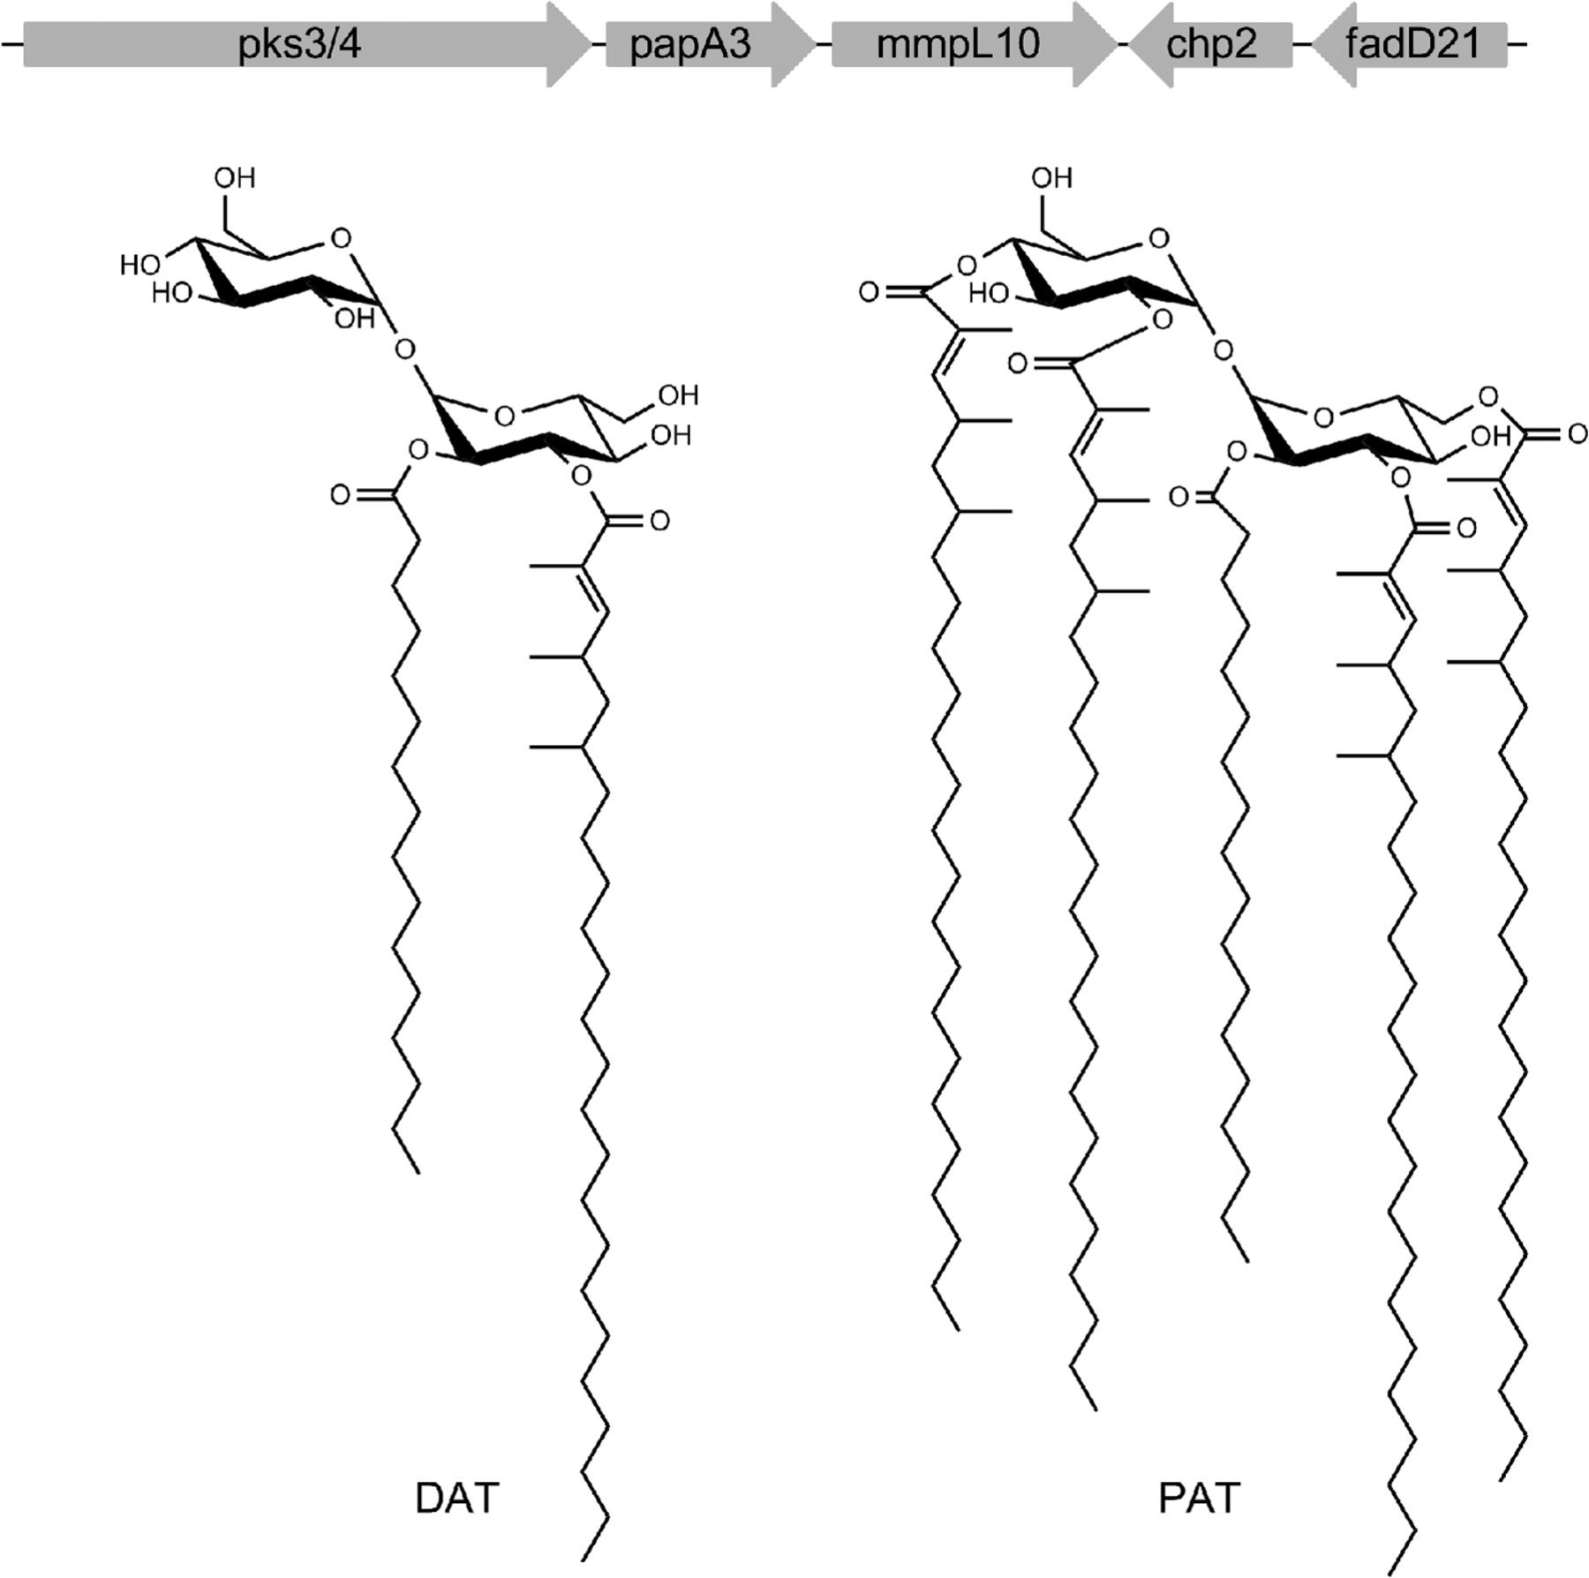
fadD21 is regulated by PhoP
Contains phoP binding site/motif (Cimino et al, 2012, PLOS One)
Possible virulence factor—involved in cell wall composition, pH regulator
FadD21 (with PapA3 and Pks3/4) generate diacyl trehalose (DAT) on cytosolic face of PM (Belardinelli et al, 2014, JBC)
DAT substrates converted to PAT by Chp2 and transported to periplasmic space by MmpL10
fadD21 is overexpressed in NRP1 and NRP2 with mixed lipids/cholesterol (causes reductive stress and accumul of toxic compounds such as proprionyl-CoA) (Soto-Ramirez et al, 2017, Tuberculosis)

Slide 28
MB1552 wbbL2 (Rv1525)
in Mtb (100% identity in 261 aa overlap)
Non-essential gene for in vitro growth of H37Rv, by analysis of saturated Himar1 transposon libraries (see DeJesus et al. 2017). Essential by Griffin et al 2011
Found to be deleted (partially or completely) in one or more clinical Mtb isolates (See Tsolaki et al., 2004).
TRANSIT-HMM: NE in negative, GD in positive
Important in cell envelope integrity:
Involved in cell wall arabinogalactan linker formation (links mycolyl-arabinogalactan to peptidoglycan layer)
Phosphorylated by PknG in vitro (Deng et al, 2014, Cell Reports)
Uses dTDP-L-rhamnose as substrate to insert the rhamnosyl residue into the cell wall (Deng et al, 2014, Cell Reports). Rhamnose is glycan not found in humans
Part of operon Rv1523, Rv1524 and Rv1525

Slide 29
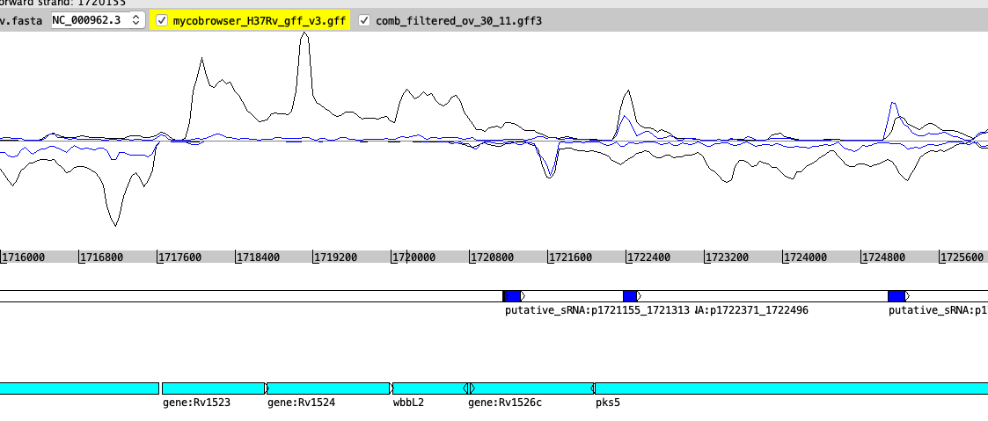
Head-to-head txn of Rv1525 with Rv1526 (and pks5)
Putative sRNA could also be a 3’ UTR from run-on txt of Rv1525/wbbL2 (TSS at 1721140)
Extended 3’ UTR is antisense to Rv1526 in exponential, not really expressed in extended hypoxia

Slide 30
Mb1819 / Rv1791 PE19
Only 6 sites (short gene ~99 amino acid PE domain)
TRANSIT-HMM: NE in both Men + and Men
Attenuated in-vivo and in Bellerose 2020
Role in membrane permeability (Ramakrishnan, 2016, Infection and Immunity): Deletion of pe19 suppressed hypersensitivity of ∆pstA1 (phosphate uptake system component mutant) to detergent and ROS, pe19 was necessary for increased envelope permeability of ∆pstA1, and overexpression causes increased membrane permeability—sensitizes to host immunity
Associated with PPE51 (and necessary for export of PPE51); probably duo forms a small-molecule channel embedded in the PDIM which allows import of nutrients etc through impermeable PDIM containing cell envelope (Wang et al, 2020 Science)

Slide 31
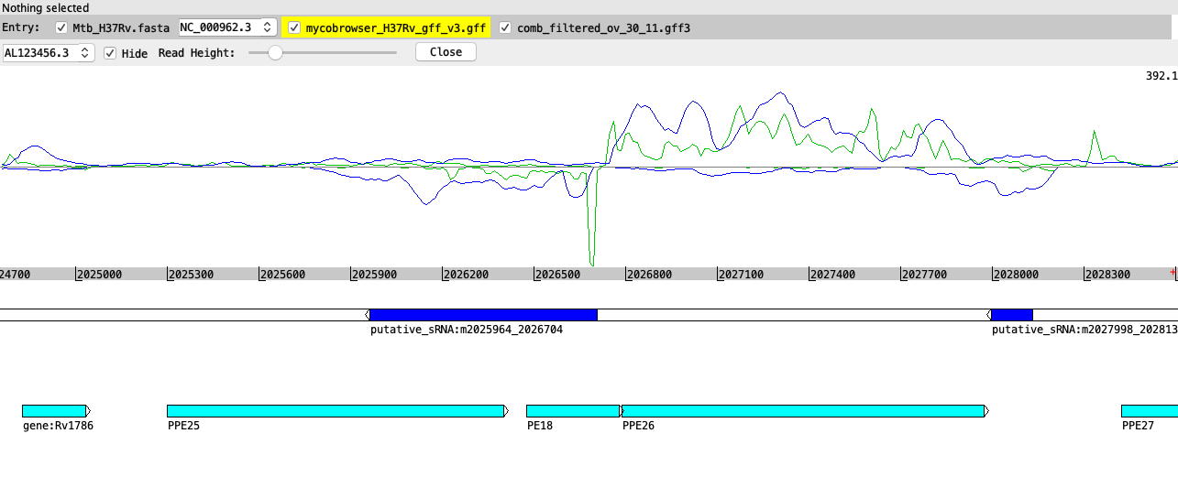
Overexpression of antisense-PE18 (PE18 is 89% identical to PE19) negatively regulates expression of PE19 (Wang et al, 2020) (TSS at 2026704)

Slide 32
MB2497 glbO/trHbO, oxygen-binding protein (globin)
Rv2470 (100.0% identity in 128 aa overlap)
Attenuated in some samples in-vivo but NS
‘Truncated hemoglobin protein’ (Mtb has two—GlbO and GlbN)
GlbO well conserved among all pathogenic and non-pathogenic strains
Associates to cell membrane and interacts with lipids (non-specifically) and oxidase cytochrome o complex (cyo complex)
Supports survival in low oxygen env, ’collector’/reservoir? (Liu et al, 2004, biochem and Biophys Res Comm)
Promoter fusions show increased expression in oxidative stress (H2O2) and metal-induced hypoxia (NiCl2) and lower expression in low iron, increased in infected macrophages after 48 h (Pawaria et al 2008, Applied and Env Micro)
Hub in darkolivegreen (module enriched for virulence/detox/adaptation)

Slide 33
MB2636c, snoP (Rv2604c) (aka Pdx2/PLP synthase)
2979.5 | 4.06
2979.5 | 4.06
“probable glutamine amidotransferase” (mycobrowser)
Only has 3 ‘permissive’ TA sites (out of 4 total)
NE in both positive and negative conditions
Huge difference in number of reads at these sites (>2900 v 4)—may bear looking into
NE in DeJesus et al, 2017 and earlier studies
Appeared severely attenuated in the in vivo study but NS, attenuated in mouse model Bellerose, 2020
Shown to be required for growth of Mtb in vivo (with Pdx1 knock-out, Dick et al, 2010)
In pink module (MM=0.74) which is enriched for information pathways genes

Slide 34
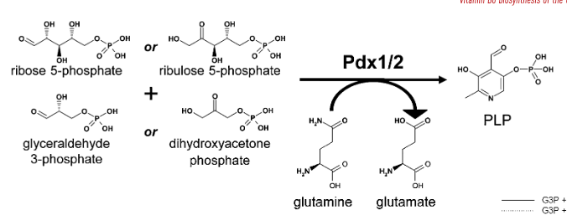
Pdx2/PLP synthase involved in biosynthesis of pyridoxine/pyridoxal 5-phosphate (PLP)
De novo biosynthesis of PLP involves rxn catalysed by 2-enzyme complex: Pdx1(Rv2606c) and Pdx2(Rv2604c)
PLP (vitamin B6) is an essential cofactor for 58 putative PLP-binding proteins and a potential antioxidant (Ankisettypalli et al 2016, FEBS letters)
PLP biosynthesis (by Pdx complex) required for survival of Mtb in vivo. involved in amino acid metabolism, biosynthesis of other cofactors (biotin, folate and cobalamin), formation of cell wall components and DNA synthesis (Dick et al, 2010, Mol Micro)
Pyrodoxine is quencher of ROS intermediates (Dick etal, 2010; Matxain et al, 2009 Jnl of Physical Chem Letters)
Target for isoniazid and cycloserine
From Dick et al, 2010, Mol Micro

Slide 35
Mb3080c (Rv3054c) NADPH:quinone oxidoreductase mutations are over-represented in men +
6 TA sites
log2FC of 3.4 (> 10X increase in Men+)
TRANSIT HMM: GA in men + condition, NE in men – condition
soluble quinone oxidoreductases (QORs) catalyze transfer of electrons from NADPH to substrates
PFAM P95105_MYCTU: NADPH-dependent FMN reductase-like domain-containing protein
Other NADH-quinone oxidoreductases in Mtb genome (Rv1854c/ndh and Rv0392c/ndhA) with ndhA thought to be redundant. Catalyses oxidation of NADH to NAD+ with simultaneous reduction of menaquinone to menaquinol (ndh is membrane-bound)
ndh mutations slightly overrepresented (NS) and ndhA mutations slightly attenuated (NS)
Menadione is menaquinone analog
In humans: NAD(P)H quinone oxidoreductase 1 (NQO1) catalyses the two electron reduction of quinones and a wide range of other organic compounds. Its physiological role is believed to be partly the reduction of free radical load in cells and the detoxification of xenobiotics. It is often over-expressed in cancer cells and as such is considered as a possible drug target. (Pey et al, 2019, Biosci Rep)
Hub in green module (enriched for sRNAs, virulence/detox/adaptation and regulatory proteins, COG term: txn, regulation of macromolecule biosynthesis, etc)

Slide 36
MB1363 (Rv1328) glgP
Probable glycogen phosphorylase, GlgP
NE in saturated H37Rv (DeJesus et al, 2017)
NE in TRANSIT-HMM for both conditions
log2FC of +1.65, mutations in this gene are overrepresented ( >3-fold) in the men + condition
Converts glycogen to G1P (glucose-1-phosphate): alpha-glucan degradation, depolymerization, associated with cell membrane
G1P used in early steps of L-rhamnose synthesis (wbbL2 inserts rhamnose residue into cell wall) (Deng et al, 2014, Cell Reports)
Hub in ’tan’ module

Slide 37
Mutations in gene MB3520 (otsA) are over-represented in men + (in u-test results only)
Alpha-trehalose-phosphate synthase, Orthologous to Rv3490 (99.8% identity in 500 aa overlap).
Has adj p-value of 0.067 resampling results/ L2FC +1.94, had no insertions in any of the 28 sites in any of the control samples, A1 and C1 had inserts in 11 but exp2 had none (total sum of exp is 1585 but mean is 14)
Involved in osmoregulatory trehalose biosynthesis. Mycobacteria can produce trehalose from glucose 6-phosphate and UDP-glucose (the OtsA-OtsB pathway) from glycogen-like alpha(1-->4)-linked glucose polymers (the TreY-TreZ pathway) and from maltose (the TreS pathway) [catalytic activity: UDP-glucose + D-glucose 6-phosphate = UDP + alpha,alpha-trehalose 6-phosphate].
ES by HMM in negative but NE in positive. (as was essential, not tested in-vivo)
Significant using Mann-Whitney u-test results

